Slide 1
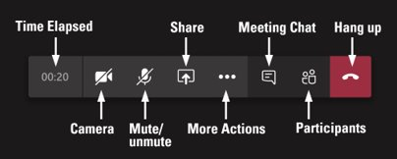
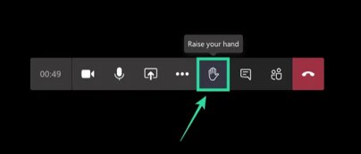
Welcome​ to Safeguarding Children Level 1 session
Tips for this session:
Take some time to make yourself comfortable and familiarise yourself with the technology. Hopefully, you have had a chance to read the Teams guidance​ if you are not used to this medium.
During the session if you could mute your mic when you are not speaking it really helps to cut down background noise​
You can also turn off your camera if you like (it may help improve your connection)​

Slide 2
Safeguarding Children A Shared Responsibility
Level One
Notes:
Hand out evaluation
Start Course:
Welcome participants
Check to ensure everyone has signed in.
Ask if everyone has their workbooks make a note of how many have
Explain ‘Common Core Compliant’:
The government introduced the common core prospectus of skills and knowledge for childrens workforce which sets out the basic skills and knowledge needed by people (including volunteers) whose work brings them into regular contact with children, young people and families and ensures that all people working with them have the best possible training, qualifications, support and advice. It also helps children and young people’s organisations and services to work together better so that the child is at the centre of all services.

Slide 3
Insert Facilitator Name

Slide 4
Name
Agency
Role

Slide 5
Staying Safe
Please note that sometimes people can find the content of some sessions upsetting. If you think this could apply to you, we would like you to think about a strategy for keeping yourself safe, for example having someone you trust available to talk to after the session.

Slide 6
Quick note:
A large amount of content is in this presentation and we apologise if some of it is difficult to read. We will be explaining the key points as we go and you can request a copy of the presentation via the evaluation form if you would like to refer back to anything.

Slide 7
Please maintain utmost confidentiality in relation to cases and service users

Slide 8
Learning outcomes at the end of this session you should understand your role and:
Know what child abuse and neglect are
Understand the importance of maintaining a child focus
Be able to recognise and identify concerns in the context of normal child development
Know what to do in response to your concerns
Notes:
Comment:
Explain that this is a generic course therefore some of the content will be more relevant to some professionals in their day to day work than others; although it will give everyone a sound knowledge of the basic principles involved in safeguarding children.
Go through stated learning outcomes for the course.

Slide 9
Child Definition
A child is anyone who has not yet reached their 18th birthday
(Ref. Children Act 1989 and 2004)
Even if a child has reached 16 years of age, is living independently or is in further education, is a member of the armed forces, is in hospital, or in custody in the secure estate for children and young people, does not change their status or entitlement to services or protection
(Ref. Working Together 2018 - Glossary)

Slide 10
Abuse and neglect definition
Abuse and neglect are forms of maltreatment of a child. Somebody may abuse or neglect a child by inflicting harm, or by failing to act to prevent harm.
Children may be abused in the family or in an institutional or a community setting, by those known to them or, more rarely, by others e.g. via the internet). They may be abused by an adult or adults, or another child or children
(Ref. Working Together 2018 - Glossary)

Slide 11
Key Legislation
1989
Children Act 1989
2004
Children Act 2004
2018
Working Together to Safeguard Children 2018

Slide 12
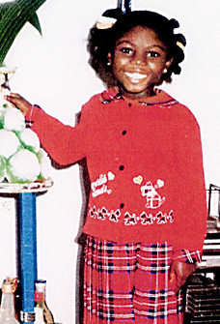
Victoria Climbie
April 1999 Victoria arrives in the UK with her Great Aunt to live in a private fostering arrangement
Within 10 months Victoria died from injuries resulting from abuse and neglect
Notes:
Additional notes:
Victoria Climbie born 2 November 1991 on the Ivory Coast
Meets her great aunt Marie Therese Kouao in October 1998.
Victoria died on the 25th February 2000
Her great aunt and her partner were arrested on suspicion of neglect. They were subsequently charged and convicted of murder on 12th January 2001.
Lord Laming’s report was published 28 January 2003 and made 108 recommendations
What is a private fostering arrangement?
An arrangement that is made privately between parents and private
foster carers for the care of a child under 16 (under 18 if disabled) by
someone other than a parent or close relative for 28 days or more
You must notify
Parents and private foster carers must notify the local authority about a
proposed placement before it takes place or if the placement has
already been made.
Professionals who come into contact with the child such as teachers,
health visitors and religious leaders are also required to ensure the
Local Authority knows about the arrangement by making a referral.
12

Slide 13
PC
Senior
House
Officer
Paediatric
Registrar
A&E Senior
House Officer
Sergeant
Sergeant
A&E
Nurse
Sergeant
Nurse 1
Sergeant
Ward Sister
Nurse 2
PC
Nurse 3
Brent Police
Hospital 1
Haringey
housing
Haringey Police
Consultant
Paediatrician
Nurse 4
NSPCC
Brent
Housing
Ealing
Housing
Social
Worker
Detective
Inspector
Church 1
Haringey
Social
Services
Church 2
Friend
VICTORIA
Team
Manager
Child Minder
Senior
Practitioner
Practice
Nurse
Distant Relative
Enfield Hospital
Social Worker
Brent
Social
Services
Taxi Driver
GP 2
Senior
Nurse
Psychology
Enfield
Social
Services
French
speaking
nurse
Nurse 3
GP 1
Senior
use
Officer
Nurse 4
Community
Health Visitor
Nurse 2
Ambulance
Nurse 5
Social
Worker 1
Paediatric
Registrar
Dermatology
Immigration
Hospital 2
Ealing
Social
Services
Registrar 3
Social
Worker 6
Social
Worker 2
Consultant
Paediatrician
Nurse 6
Nurse 1
Registrar 2
Social
Worker 5
Social
Worker 4
Social
Worker 3
Consultant
Paediatrician
A&E Casualty
Officer
Registrar 1
Notes:
13
Approximately 2-3 children die each week (so roughly 1800 have died since Victoria)
Summary of findings
‘The extent of the failure to protect Victoria was lamentable’
There were failures at every level and in every organisation
There were twelve chances for professionals to save Victoria's life. None of these were taken
Reference: CM 5730 (2003) The Victoria Climbié Inquiry. Report of an inquiry by Lord Laming. The Stationery Office, London.
Other notes
Housing departments = Ealing, Brent and Haringey
SSDs = Ealing, Brent, Enfield (because of the hospital social worker at North Middlesex) and Haringey
Trusts = Central Middlesex and North Middlesex
NSPCC centre = North Tottenham child and family centre
Police child protection teams = Brent and Haringey, both teams of the Metropolitan Police
Not a single organisation emerges with any credit from the report, and very few individuals do either.
Key themes in the report
Child protection a ‘low priority’
Lack of accountability right through the organisations to the most senior level
Under-funding and under-staffing
Repeated failures of basic professional practice
Too much, and outdated, local guidance
Staff inadequately trained in child protection
Problems in the way information was exchanged and understood

Slide 14
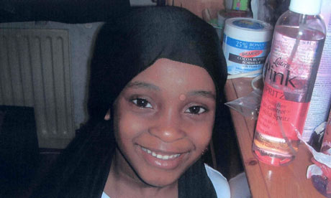
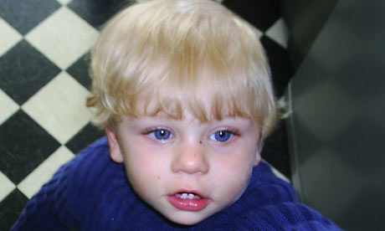
Peter Connolly
Khyra Ishaq
Notes:
After Peter died Lord Laming was asked to produce a progress report on Safeguarding to include:
What good practice had been achieved since the Victoria Climbiè Inquiry Report
What are the key barriers, including in the legal process that may impede efficient and effective work
To identify specific actions that should be taken by Government national and local to overcome the barriers
The second case review of Baby P was directly critical of practice that was:
“lacking urgency, lacking thoroughness, insufficiently challenging to the parent; lacking action in response to reasonable inference; insufficiently focused on the children’s welfare; based on too high a threshold for intervention; based on expectations that were too low.” It says the failure to establish the stepfather’s identity and run background checks on him was a “significant deficit”
(Source Community Care 28 May 2009)
Khyra Ishaq – The last 5 months of her life
6 December 2007 Khyra's mother, Angela Gordon, withdraws her from primary school, where she had a perfect attendance record.
19 December The deputy head teacher contacts the children’s services department at Birmingham city council to raise concerns about Khyra's welfare. The teacher and a colleague later visit Khyra's home but are not allowed in.
28 January 2008 Khyra's school again contacts social services to raise concerns about whether Gordon is able to meet her daughter's educational needs by home teaching. Social worker Ranjit Mann visits the house but leaves after 10-15 minutes as nobody answers the door.
29-30 January Gordon contacts Mann by phone, leaving a message, but later refuses to arrange for the social worker to visit.
8 February Educational social worker Richard Lewis and council mentor Irving Horne visit the home to offer advice on home schooling. Neither official sees any children.
21 February Social workers Sanya Scott and Anne Gondo pay a joint, pre-arranged visit to the family home but are refused entry. The women decide that they have no concerns for Khyra after she is brought to meet them at the front door.
8 March Amandeep Kaur, who lived nearby, sees Khyra dressed in underwear in the back garden of her home. She was later to tell police that it was a cold morning and the "abnormally thin" child was whimpering.
17 May Paramedics called to the house at 6am. Khyra was so thin her BMI could not be measured on any charts. She was pronounced dead in hospital.

Slide 15
Legislation Time Line:
Children Act 1989
Working Together 1999
Victoria Climbie died February 2000
Joint Chief Inspectors Report – Safeguarding Children October 2002
Lord Laming’s Inquiry Report 2003
Green Paper Every Child Matters September 2003 & March 2004
Every Child Matters – Change for Children December 2004
Children Act November 2004
Working Together to Safeguard Children 2006
Baby Peter died August 2007 – Kyra Ishaq died 2008
Lord Laming’s Progress Report March 2009
The Governments Response to Lord Laming May 2009
Working Together to Safeguard Children March 2010
The Governments Response to Lord Laming: One Year On March 2010
Change of Government 2010
Munro Review of Child Protection 2011
Working Together to Safeguard Children 2013, 2015 and March 2018

Slide 16
Daniel Pelka
Notes:
Issues:
Alcohol misuse
Domestic abuse – Police called to 27 reported incidents. SCR found all staff were naïve about the impact on children
Multiple house moves, frequent DNA’s
Referrals to CSC not acted upon
Delay in information to HV
English as second language, interpreters not used therefore Daniel’s voice not heard
Belief of accidental explanation of spiral fracture by sibling
Belief of mother of underlying explanation of Daniel’s eating behaviours
Children reported to be clean and appropriately dressed
Poor school attendance. School did not formally document Daniel’s injuries or seek explanation

Slide 17
News Report
Notes:
https://www.youtube.com/watch?v=d57Vcmxd5Xo

Slide 18
The Voice of the child
The inquiry into Victoria’s death highlighted that no one asked her what a day in her life was like.
Notes:
20. ‘Effective safeguarding systems are child centred . Failings in safeguarding systems are too often the result of loosing sight of the needs and views of the children within them, or placing the interests of adults ahead of the needs of children.’
22. ‘Anyone working with children should see and speak to the child; listen to what they have to say; take their views seriously; and work with them collaboratively when deciding how to support their needs’
COMPLETE EVALUATION SHEET VOICE OF THE CHILD

Slide 19
Who are children likely to turn to?
Friends
Mothers
Fathers
Other trusted adult
‘No matter where you work, you are likely to
encounter children during the course of your normal
working activities. You are in a unique position to be
able to observe signs of abuse or neglect, or
changes in behaviour which may indicate a child may
be being abused or neglected’
That is why safeguarding is everyone’s responsibility
Notes:
Reference quote: ‘What to do if you’re worried a child is being abused’ 2015
Reference who are children likely to turn to?
Featherstone B and Evans H (2004) Children Experiencing Maltreatment: who do they turn to? NSPCC, London. Page 24.

Slide 20
How do worries about a child come to light?
A child tells someone what is happening to them
You see signs of abuse or neglect
You see worrying changes in a child’s behaviour or moods or in a parent’s behaviour to a child
Someone else tells you about something they have seen or heard
An adult or child tells you that they have hurt a child
A parent or carer tells you that they are having problems in meeting their child’s needs

Slide 21
If a child tells…
Do’s and Don’ts exercise
Notes:
Read out each one and ask people to hold up their Do/Don’t card
Listen carefully
Record the conversation in the child’s words and note the time
Ask leading questions
Sign and date the record you make
Take it seriously
Make promises you cannot keep
Jump to conclusions
Reassure they are right to tell
Explain what will happen next
Speculate or accuse anybody
You should have a record keeping policy in your organisation (this is dealt with in more detail in level 2 and a stand alone course)
Do:
Listen carefully
Record the conversation in the child’s words and note the time
Sign and date the record you make
Take it seriously
Reassure they are right to tell
Explain what will happen next
Don’t:
Ask leading questions
Make promises you cannot keep
Jump to conclusions
Speculate or accuse anybody

Slide 22
Listen carefully
Record the conversation in the child’s words and note the time
Ask leading questions
Sign and date the record you make
Take it seriously
Make promises you cannot keep
Jump to conclusions
Reassure they are right to tell
Explain what will happen next
Speculate or accuse anybody

Slide 23
REMEMBER It is the responsibility of Children’s Social Care / the Police to investigate and to decide if an allegation is true or not

Slide 24
Categories of Abuse from Working Together (2018)
Emotional
Physical
Sexual
Neglect
Notes:
Divide people into 4 groups and give them a category of abuse – definitions are on the next four slides which can be printed out if necessary
For information the other categories of abuse for adults are:
Discrimination
Institutional
Financial
And the Care Act 2014 added:
Modern Slavery
Domestic Abuse
Self Neglect

Slide 25
Emotional abuse:
Emotional abuse is the persistent emotional maltreatment of a child such as to cause severe and persistent adverse effects on the child’s emotional development. It may involve conveying to children that they are worthless or unloved, inadequate, or valued only insofar as they meet the needs of another person. It may include not giving the child opportunities to express their views, deliberately silencing them or ‘making fun’ of what they say or how they communicate.
It may feature age or developmentally inappropriate expectations being imposed on children. These may include interactions that are beyond the child’s developmental capability, as well as overprotection and limitation of exploration and learning, or preventing the child participating in normal social interaction.
It may involve seeing or hearing the ill-treatment of another. It may involve serious bullying (including cyberbullying) causing children frequently to feel frightened or in danger, or the exploitation or corruption of children.
Some level of emotional abuse is involved in all types of maltreatment of a child, though it may occur alone.

Slide 26
Physical abuse:
Physical abuse may involve hitting, shaking, throwing, poisoning, burning or scalding, drowning, suffocating, or otherwise causing physical harm to a child.
Physical harm may also be caused when a parent or carer fabricates the symptoms of, or deliberately induces illness in a child (formally known as Munchausen Syndrome by proxy)

Slide 27
Sexual abuse:
Sexual abuse involves forcing or enticing a child or young person to take part in sexual activities, not necessarily involving a high level of violence, whether or not the child is aware of what is happening.
The activities may involve physical contact, including assault by penetration (e.g. rape, or oral sex) or non-penetrative acts such as masturbation, kissing, rubbing and touching outside of clothing.
They may also include non-contact activities, such as involving children in looking at, or in the production of, sexual online images, watching sexual activities, or encouraging children to behave in sexually inappropriate ways, or grooming a child in preparation for abuse (including via the internet). Sexual abuse is not solely perpetrated by adult males. Women can also commit acts of sexual abuse, as can other children.

Slide 28
Neglect:
Neglect is the persistent failure to meet a child’s basic physical and/or psychological needs, likely to result in the serious impairment of the child’s health or development.
Neglect may occur during pregnancy as a result of maternal substance abuse. Once a child is born, neglect may involve a parent or carer failing to:
provide adequate food and clothing, shelter (including exclusion from home or abandonment)
protect a child from physical and emotional harm or danger
ensure adequate supervision (including the use of inadequate care-takers)
ensure access to appropriate medical care or treatment.
It may also include neglect of, or unresponsiveness to, a child’s basic emotional needs.

Slide 29
Signs and indicators of abuse
Consider the definition you have been given.
Think about the things you might see, hear or feel that would suggest this type of abuse is occurring and the behaviours you might see in a child or young person who has experienced this
Notes:
Consider a short break after this exercise

Slide 30
Accidental v’s Non-accidental Injury
Talk to the person next to you
Notes:
Group exercise:
Accidental and non accidental injuries have to be seen in the context of child development
A child can only fall out of a tree by accident if they are capable of climbing it in the first place
So look at the age range you are about to be given and write down what a child of this age can do physically and also what types of accidental injuries you may expect to see.
Use the workbook/pictures to identify what they think are accidental and non accidental injuries of their particular age group
Birth – 3 months and up tp 12 months
Pre school
Primary school
Teenagers

Slide 33
Victoria’s death changed the view of Child Protection to Safeguarding Children
There are two parts to safeguarding children:
a duty to protect children from maltreatment
a duty to prevent impairment
Notes:
33
Department of Health, Department for Education and Employment and Home Office (2000) Framework for the Assessment of Children in Need and their Families. The Stationery Office, London. Paragraph 1.5.
Remind group of the role of LSCB, it has a wider remit than the ACPC had:
Change of language can be a powerful tool and is much less threatening for children and families
The LSCB will has a strong preventative role, as well as the protective role.
For example:
The LSCB will take a role in road planning around accident hot spots and late licensing applications in case they affect children’s lives.

Slide 34
Sharing Information
Child Protection / referral to social care
Staff conduct, training and supervision
Lead Officer
Child protection and anti bullying Policies
Activities / curriculum
Safeguarding children
Managing Allegations Against Staff
Attendance and registration
Health and Safety
Building Design
Behaviour Management
Safe Recruitment and Selection
Whistleblowing
Notes:
Attendance and registration – mention whereabouts of children and staff
Behaviour management – mention children and staff code of conduct

Slide 35
Expectations for organisations

Slide 36
Sharing Information
Keeping children safe from harm requires professionals and others to share information
In many cases it is only when information from a range of sources is put together that a child can be seen to be in need or at risk of harm.
Don’t think “What if I’m wrong?” Think “What if I’m right?”
Notes:
133
New Information sharing guide March 2015 referenced in handout
It is good practice to get permission from an individual before you share personal information about them to another
However the law recognises that sharing confidential information without permission or a court order may be justified in the public interest to prevent harm to others
Why share information?
Children have a right to be safe and well
Adults have a responsibility to safeguard children
You have one small piece of the jigsaw
Abuse and neglect are damaging
If children and families are given help it can stop a child from being harmed
Child abuse and neglect continue because of the secrecy and silence that surround them
Children rarely lie about abuse
An abuser may abuse many other children who also have a right to protection

Slide 37
Sharing Safeguarding Concerns
This is what I have seen and/or heard: when, who from and where
This is my worry/concern
This is how I responded at the time
This is what I have done since
What more do I need to do?

Slide 38
Who do you share information with?
It is your responsibility to share your concerns with your own supervising officer
What should they then do?
Take the appropriate action - see referral form next slide They may or may not keep you informed of progress as child protection information is shared on a need to know basis
Notes:
What can you do if you are not satisfied with your lead safeguarding officers action?
You should first follow your organisations guidelines
If you are still concerned you can refer to children’s social care
yourself
Taken out of What should they then do?
Let you know what is going to happen next
keep you informed of progress

Slide 39
Making a referral to social care via the new website - www.newcastlesafeguarding.org.uk
Notes:
To show what the new website looks like and where to find the online referral forms the next slide shows what you see if you click on the report a concern link.

Slide 40
There are two secure online referral forms one for professionals and one for the public
Notes:
If you scroll down you can also make a referral for an adult

Slide 41
The professional referral form has the assessment diamond on it

Slide 43
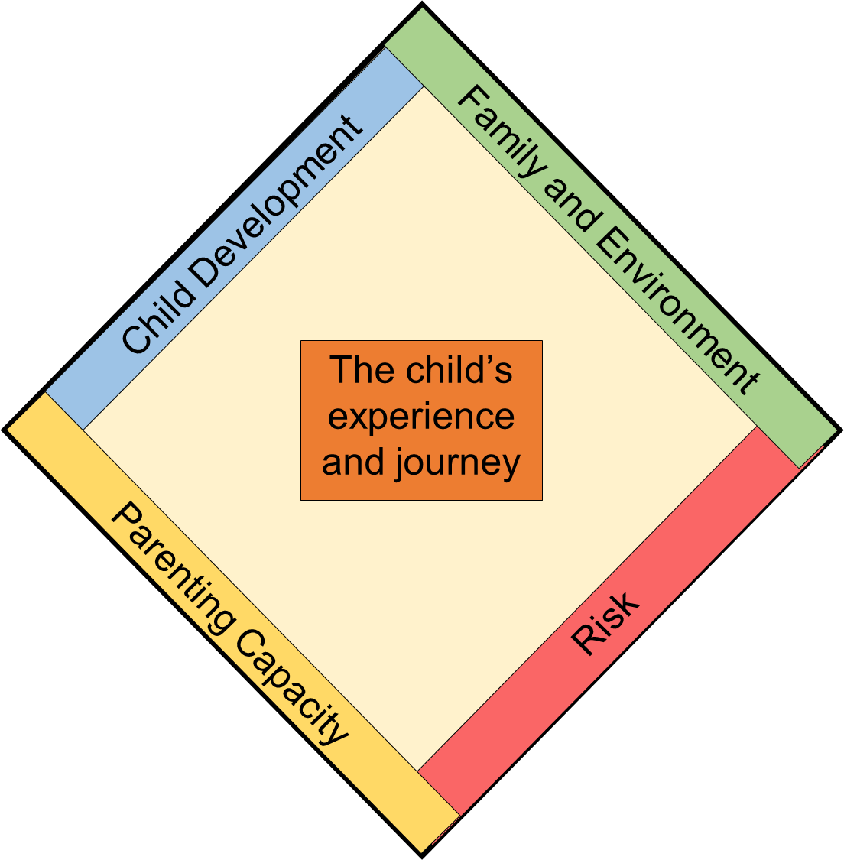
Emotional & Behavioural
Family functioning
Presentation
Housing
Family networking
Abilities & Skills
Employment
Relationships
Income
Education
Family history
Identity
Social interaction
Health
Community
Who’s who
Motivation
Protection
Safety
Harm and severity
Basic care
Parental cooperation
Anticipated future impact
Stimulation
Impact on child now
Guidance & Boundaries
Concerns & Strengths
Ability to change
Causal factors
Stability & Security
Timeliness
Notes:
Watch the video and consider what they find out about these areas from the video

Slide 44
Managing allegations against staff
Working Together 2015 says there should be clear policies in line with those from the LSCB for dealing with allegations against people who work with children. An allegation may relate to someone who has:
behaved in a way that has harmed a child, or may have harmed a child
possibly committed a criminal offence against or related to a child
behaved towards a child or children in a way that indicates they may pose a risk of harm to children
Newcastle LADO 277 4636 to provide advice and guidance
Notes:
The LADO may be an individual or a team of people WT 2015 says that allegations no longer have to be put through social care but they must be coordinated and all new appointments to the LADO’s position have to have a social work qualification.
In Newcastle the LADO has always been separate from Social Care as it sits in the Safeguarding Unit

