Slide 1
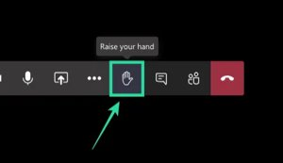
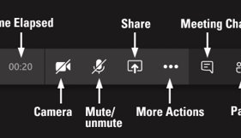
Welcome​ to Safeguarding Children Level 2 session
Tips for this session:
Take some time to make yourself comfortable and familiarise yourself with the technology. Hopefully, you have had a chance to read the Teams guidance​ if you are not used to this medium.
During the session if you could mute your mic when you are not speaking it really helps to cut down background noise​
You can also turn off your camera if you like (it may help improve your connection)​

Slide 2

We are Insert facilitator name

Slide 3

Staying Safe
Please note that sometimes people can find the content of some sessions upsetting. If you think this could apply to you, we would like you to think about a strategy for keeping yourself safe, for example having someone you trust available to talk to after the session.
If you want to, you can talk outside the session to a trainer, or seek advice from the NSPCC Helpline 0808 800 5000

Slide 4

Quick note:
A large amount of content is in this presentation and we apologise if some of it is difficult to read. We will be explaining the key points as we go and you can request a copy of the presentation via the evaluation form if you would like to refer back to anything.

Slide 5

Please maintain utmost confidentiality in relation to cases and service users

Slide 6

Introductions
Name
Agency
Role

Slide 7
Learning outcomes by the end of the training the participants will:
Evaluate your learning from level one
Identifying the most vulnerable and additional risk factors
Know your own and other inter-agency roles and responsibilities for safeguarding children
Understand the importance of documenting, recording and sharing information
Practice using the framework for the assessment of children and their families
Understand the key safeguarding terms associated with social care processes and the thresholds for intervention in the lives of children
Notes:
Comment:
Explain this is a generic course therefore some of the content will be more relevant to some professional in their day to day work than others; although it will give everyone a sound knowledge of the basic principles involved in safeguarding children
Go through stated learning outcomes for the course

Slide 8


Notes:
Type your answers in the chat of doing via teams or shout out if face to face

Slide 9
1. Working Together (WT 2018) to Safeguard Children defines a child as anyone who has not yet reached their…..?
16th - A
18th – B
21st - C
Birthday
18th

Slide 10
Other things to consider at:
Age13
  Gillick Principles and Frazer Guidelines
Age16
  The Mental Capacity Act
Age 17 plus
  Transitions from Children's Social Care to Adult Social Care

Slide 11
2. According to the ‘WT 2018’ definition somebody may abuse or neglect a child by. ‘failing to act to prevent harm’
True – A False – B
True
3. Children can not be abused by another child or children
True – A False – B
False

Slide 12
4. Which of the following are key pieces of legislation or guidance regarding safeguarding children?
Children Act 1989 - A
Children Act 2004 - B
Working Together to Safeguard Children 2018 – C
All of them – D
All of them

Slide 13
5. Victoria Climbie was seen by many services and professionals, which service did she not come into contact with?
Education - A
Social Care - B
Police – C
Education

Slide 14
PC
Senior
House
Officer
Paediatric
Registrar
A&E Senior
House Officer
Sergeant
Sergeant
A&E
Nurse
Sergeant
Nurse 1
Sergeant
Ward Sister
Nurse 2
PC
Nurse 3
Brent Police
Hospital 1
Haringey
housing
Haringey Police
Consultant
Paediatrician
Nurse 4
NSPCC
Brent
Housing
Ealing
Housing
Social
Worker
Detective
Inspector
Church 1
Haringey
Social
Services
Church 2
Friend
VICTORIA
2/11/1991 to 25/2/2000
Team
Manager
Child Minder
Senior
Practitioner
Practice
Nurse
Distant Relative
Enfield Hospital
Social Worker
Brent
Social
Services
Taxi Driver
GP 2
Senior
Nurse
Psychology
Enfield
Social
Services
French
speaking
nurse
Nurse 3
GP 1
Senior
use
Officer
Nurse 4
Community
Health Visitor
Nurse 2
Ambulance
Nurse 5
Social
Worker 1
Paediatric
Registrar
Dermatology
Immigration
Hospital 2
Ealing
Social
Services
Registrar 3
Social
Worker 6
Social
Worker 2
Consultant
Paediatrician
Nurse 6
Nurse 1
Registrar 2
Social
Worker 5
Social
Worker 4
Social
Worker 3
Consultant
Paediatrician
A&E Casualty
Officer
Registrar 1
Notes:
14
Summary of findings There were 108 recommendations in Lord Lamings Report
Victoria was known to three housing departments, four children's social care departments, two GPs, two hospitals, a NSPCC-run family centre and two police child protection teams, three faith based settings and had access to a child minder.
‘The extent of the failure to protect Victoria was lamentable’
There were failures at every level and in every organisation
There were twelve chances for professionals to save Victoria's life. None of these were taken
Reference: CM 5730 (2003) The Victoria Climbié Inquiry. Report of an inquiry by Lord Laming. The Stationery Office, London.
Other notes
Housing departments = Ealing, Brent and Haringey
SSDs = Ealing, Brent, Enfield (because of the hospital social worker at North Middlesex) and Haringey
Trusts = Central Middlesex and North Middlesex
NSPCC centre = North Tottenham child and family centre
Police child protection teams = Brent and Haringey, both teams of the Metropolitan Police
Not a single organisation emerges with any credit from the report, and very few individuals do either.
Key themes in the report
Child protection a ‘low priority’
Lack of accountability right through the organisations to the most senior level
Under-funding and under-staffing
Repeated failures of basic professional practice
Too much, and outdated, local guidance
Staff inadequately trained in child protection
Problems in the way information was exchanged and understood

Slide 15
6. Which two of the following are not categories of abuse for children according to WT to safeguard children?
Neglect - A
Physical - B
Financial - C
Emotional - D
Discrimination - E
Sexual – F
Financial and Discrimination

Slide 16
7. The following policies have been jumbled up. Each one is designed to keep children safe in your organisation. Can you correctly pair them together?
 | Sharing | A | Design
 | Staff Conduct, | B | and Selection
 | Record | C | against staff
 | Safe Recruitment | D | and Safety
 | Managing allegations | E | Information
 | Building | F | to children
 | Health | G | Keeping
 | Talking and listening | H | Training and Supervision
E
H
G
B
C
A
D
F

Slide 17
8. It is the parent /carers responsibility to ensure adequate supervision (including the use of adequate carers) failure to do this could be seen as…..What type of abuse?
Neglect - A
Physical - B
Sexual - C
Emotional - D
Neglect

Slide 18
9. Two young children regularly hear their parents shouting and screaming at each other and they sometimes hear bangs and clashes and mum crying, they are scared. What type of abuse would be suspected in terms of the two children?
Neglect - A
Physical - B
Sexual - C
Emotional - D
Emotional

Slide 19
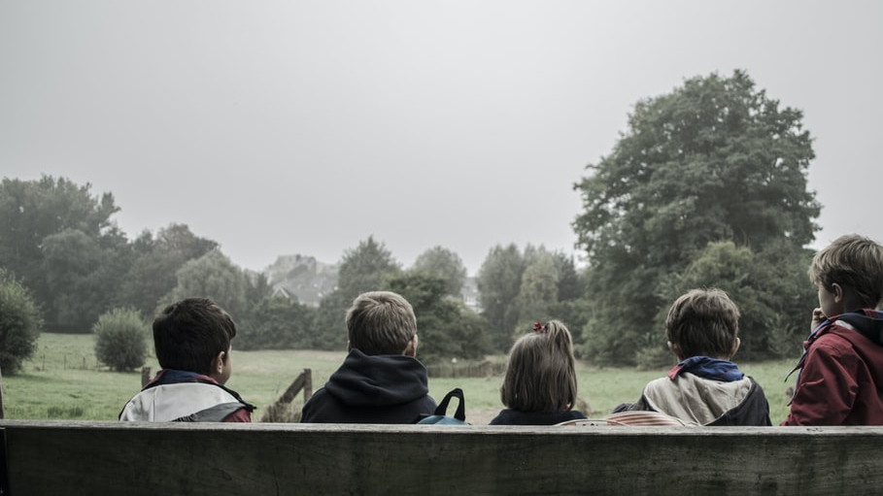
10. Who are the most vulnerable groups?
Please comment in the chat room why these children might be vulnerable.
The very young
Children with disabilities
Children who live with domestic abuse
Teenagers
Notes:
Exercise: flip cart paper & pens why do you think this group is vulnerable
Split into 4 groups, very young, disabled, living with domestic abuse, teenagers
Very young children – Gordon R & Harran E (2001) Fragile:Handle with Care. Protecting babies from harm, NSPCC
The under ones are statistically the age band most at risk of abuse. The homicide rate for under-ones is nearly five times greater than the average
One survey found that 52 % of one year old childen were hit or smacked weekly by their parents
Babies under one had the highest registration rate on the child protection register before the changes to the register
Children with Disabilities
Often treated as different, are less likely to receive adequate sex education or information about their own bodies
Generally more isolated, both physically and socially and also from mainstream facilities and services
More likely to spend time in residential care and therefore have increased vulnerability to potential abusers
At an increased risk of abuse because of using different systems of communication or may have restricted mobility
More likely to rely on others for personal and intimate care
Children who live with Domestic Abuse – Making an impact children and domestic violenc A Reader. NSPCC. Barnardos and University of Bristol, 1998
The domestic violence perpetrator may also be directly physically and or sexually – abusive to the child
Witnessing violence towards a parent may have an abusive impact on the children
Perpetrators may abuse the child as part of their violence against their partner
Teenagers – May not recognise their own vulnerability
‘Vulnerable Young peoples guide’ Young people with additional needs are at risk of problems such as substance misuse, offending, teenage pregnancy and homelessness. They are likely to experience one or more of the following, Persistent absence or exclusion from school, behavioural problems, poor emotional or coping skills, poor mental health, attitudes that condone risky behaviour, learning dificulties and or disability, poor aspirations, poor family support, family conflict or problems such as parental substance misuse, poor support networks, living in a deprived area, poverty
What else makes children more likely to suffer harm –
Picked on as being different (asylum seeking/refugee children; black children)
They are already thought of as being a problem (children in care; children in secure accommodation)
Their parents may be suffering mental health problems or who are a problematic Substance misuser

Slide 20
Additional risk factors
Culturally harmful practices e.g. FGM, FM, Belief in Spirit Possession
Exploitation, sexual, slavery and trafficking
Online safety/sexting
Young carers
Questioning sexuality or gender
Vulnerable to extremist ideologies
Living with someone other than biological parents
Showing signs of being drawn into anti social or criminal behaviour, including gang involvement
Has returned home to their family from care
Is privately fostered
Is misusing drugs or alcohol themselves
Was Not Brought, missing appointments
Notes:
FGM=Female Genital Mutilation
FM=Forced Marriage

Slide 21

Take a break
Please be ready to start again in 10 minutes

Slide 22
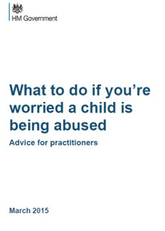

Slide 23

Roles and responsibilities of ​key professionals in the safeguarding processes ​
For more detailed information refer to Working Together to Safeguard Children 2018​
Notes:
23
Flip Chart Exercise
Four Groups each takes one of the following:
Children’s Services Care
Police
Health
Education
NSPCC
The NSPCC is the only voluntary agency named in law as authorised to take legal action to safeguard and promote the welfare of children. It can therefore act independently of social services in safeguarding the welfare of a child.
Other agencies
Increasingly all agencies whether voluntary or private have a designated person for Safeguarding Children.
Refer concerns to children’s social care where the child may be a child in need, including concerns about significant harm
Refer to children’s social care or the police where emergency action is required to secure the immediate safety of a child
Provide information and reports to children’s social care to help make decisions about how best to safeguard and promote the welfare of a child
Provide specialist and therapeutic services to children and families
Local Authority Children’s Social Care are the lead agency that investigates concerns about children’s welfare. The LA and the NSPCC have the right to apply to court for orders, neither have any powers to remove children without a court order.
The Police, investigate criminal offences against children and do have immediate powers to safeguard children under Police Protection.
Health provide ongoing medical assessment and treatment to all children, however also provide expert evidence and therapeutic work with children and families in relation to safeguarding
Education provide a monitoring and also educative role with children on how to keep themselves safe,.
Other agencies provide monitoring and in some non-governmental agencies specialist therapeutic services.
All agencies have to have lead persons or designated officers for safeguarding.
DBS (Disclosure and Barring Service) checks and vetting apply to all workers working with children and families.

Slide 24

POLICE​
Emergency police protection-take children into care for 72 hours​
Can access housing​
Domestic violence (DV) refer on via Child Concern Notification (CCN) to Children's Social Care (CSC)​
Arrest people and question​
Take referrals from public​
Public protection – Multi agency public protection arrangements (MAPPA)​
Attend strategy meetings and conferences to share information​
Confiscate alcohol on the streets​
Investigate crime​
Speak to the child, trained in ‘Achieving Best Evidence’ (ABE)
Representative on Local safeguarding children
partnership (LSCP)​
Chair Multi Agency Risk Assessment Conference (MARAC)​
Be approachable​
Education​, School liason
Part of Multi agency safeguarding hub (MASH)

Slide 25

HEALTH​
Attend strategy meetings and conferences to share information​
Remain child focused​, speak to the child
Complete document injuries on body charts​
Use relevant specialist safeguarding team if concerned – Nurse advisors or child protection (CP) medical doctors​
Refer cause for concern​
Observations​
Follow up care​
Identify diagnose cause of injuries​
Early Help Assessment and Plan (EHAP)​
Support families​
Record keeping​
Monitor child development and growth​
Assessment of family​
Healthy child programme​
Report writing for conferences​
Contribute to MARAC-MASH-MAPPA​
Sexual health of young people ​
Refer to children and young people’s service (CYPS) mental health​

Slide 26

CHILDRENS SOCIAL CARE​
Safety and welfare of children​
Information sharing multi agency​
Make referrals in and out to health – medicals, second opinions​
Accurate record keeping​
Multi-Disciplinary Team (MDT) support​
Contribute to MARAC-MASH-MAPPA​
Responsible for conferences and other meetings​
Liaise to support families​
Core and initial assessments​
Section 17 and 47 assessments​
Strategy meetings​
Core and Care team meetings​
Identify additional support networks- voluntary, family and friends, professionals
Work with and provide training for Foster Carers

Slide 27

EDUCATION​
Designated officer​
School health advisor​
All staff have responsibility for safeguarding and complying with “keeping children safe in education and working together”​
Monitoring attendance (attendance officers) and academic progress​
Talking to parents and carers​
Information sharing with other professionals​
Remain child focused – make opportunities available to speak to the child alone​
Home visits in nursery early indication of problems​
Identify changes in behaviour or presentation​
Counselling​
Drop in sessions​
Early Help and Assessment Plans (EHAP)

Slide 28
Other agencies and the wider environment:
Who may or may not have a relationship with the child or have information to add to the jigsaw
Housing Organisations, Youth Justice Service, Probation Service
Toddler groups, Nursery, Play and Youth facilities
Scouts, Brownies and Guides
Drama, Music and Dance groups, TV and Film, Modelling
Foster Carers, Child Minders, Chaperones
Sports Clubs
Local Community Group/Centre, Neighbours and the Wider family
Free and International Schools, Breakfast and After school clubs
Faith Organisations
Taxi, Bus and Coach drivers
Railways and Bus stations
Theatres, Cinemas, Hotels, Pubs and Clubs

Slide 29
Four steps to follow to help you identify and respond appropriately
Be alert
Question behaviour
Ask for help
Refer-Lead for Safeguarding
Notes:
It may not always be appropriate to go through all four stages in order. If a child is in immediate danger or at risk of harm, you should refer to children’s social care or the police
Reference What to do if you’re worried a child is being abused 2015

Slide 30
What should the Lead Safeguarding Officer do next ?
This person will have a clear understanding of your organisations procedures and they will
Take the appropriate action
Let you know what is going to happen next
Keep you informed of progress

Slide 31
What can you do if you are not satisfied with your lead safeguarding officers action?
You should first follow your organisations guidelines
If you are still concerned or disagree you can refer to children’s social care yourself using the online referral form or calling Initial Response Service 0191 277 2500 or The Emergency Duty Team 0191 278 7878 out of hours service
Professionals should follow up their concerns if they are not satisfied with children’s social care response

Slide 32
How might you be involved?
You may have concerns about a child, and refer them to your manager or lead safeguarding officer, or directly to children's services or the police
You may be approached by children's services for information about a child or family or be involved in an assessment
You may be asked to provide help or a specific service to the child or family as part of an agreed plan and contribute to the reviewing of the child's progress

Slide 33
Why share information?
Children have a right to be safe and well
Adults have a responsibility to safeguard children
You have one small piece of the jigsaw
Abuse and neglect are damaging
If children and families are given help it can stop a child from being harmed
Child abuse and neglect continue because of the secrecy and silence that surround them
Children rarely lie about abuse
An abuser may abuse many other children who also have a right to protection
Notes:
33
50

Slide 34
There are seven golden rules for information sharing:
1 Remember that the Data Protection Act is not a barrier to sharing information…
2 Be open and honest…
3 Seek advice…
4 Share with consent where appropriate…
5 Consider safety and well-being…
6 Necessary, proportionate, relevant, accurate and secure…
7 Keep a record…
There is a new Information Sharing –
Advice for practitioners March 2015
Notes:
1 Remember that the Data Protection Act is not a barrier to sharing information but provides a framework to ensure that personal information about living persons is shared appropriately
Be open and honest with the person (and/or their family where appropriate) from the outset about why, what, how and with whom information will, or could be shared, and seek their agreement, unless it is unsafe to do so
Seek advice if you are in any doubt, without disclosing the identity of the person where possible
Share with consent where appropriate and, where possible, respect the wishes of those who do not consent to share confidential information. You may still share information without consent if, in your judgement, that lack of consent can be overridden in the publics interest. You will need to base your judgement on the facts of the case.
Consider safety and well-being: Base your information sharing decisions on considerations of the safety and well-being of the person and others who may be affected by their actions
Necessary, proportionate, relevant, accurate, timely and secure: Ensure that the information you share is necessary for the purpose for which you are sharing it, is shared only with those people who need to have it, is accurate and up-to-date, is shared, in a timely fashion, and is shared securely
Keep a record of your decision and the reasons for it – whether it is to share information or not. If you decide to share, then record what you have shared, with whom and for what purpose.

Slide 35
Good practice for record keeping
Everyone should have their own agreed record keeping procedures, including recording any allegation or concern ASAP.
All written records or electronically stored records must be secure and information must only be shared on a need to know basis.
Factual when using opinion this should be stated in a non-judgemental or blaming way, including the clients views and wishes
Plain English and using the persons own language and words.
Should be dated and signed.
The quality of referral or the information supplied is key make sure you supply comprehensive information to Children’s Social Care
Use the referral document (can be completed online) and the assessment framework to guide your referral
Accurate records are a protective tool for staff and children if used correctly.

Slide 36
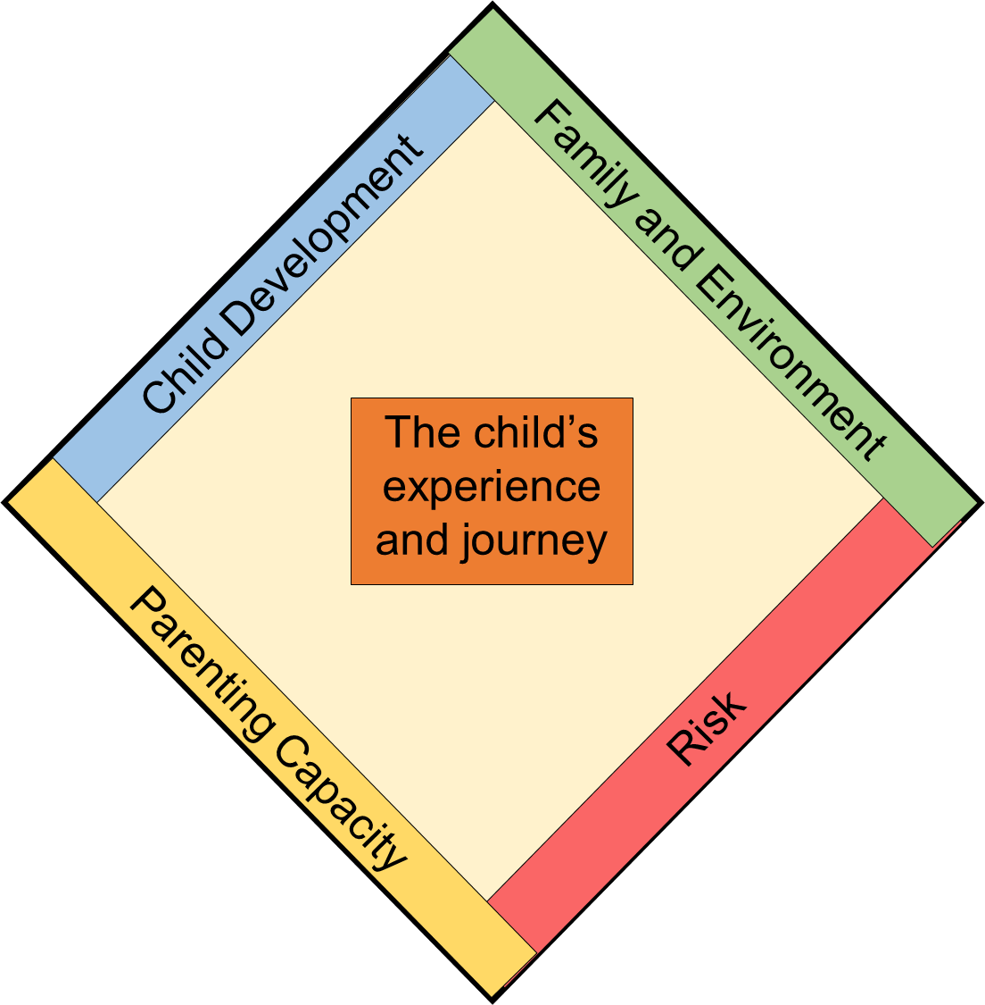

Emotional & Behavioural
Family functioning
Presentation
Housing
Family networking
Abilities & Skills
Employment
Relationships
Income
Education
Family history
Identity
Social interaction
  Health
Community
Who’s who
Motivation
Protection
Safety
Harm and severity
Basic care
Parental cooperation
Anticipated future impact
Stimulation
Impact on child now
Guidance & Boundaries
Concerns & Strengths
Ability to change
Causal factors
Stability & Security
Timeliness

Slide 37
Continuum of help and support – Thresholds
2
Additional needs met by Universal and Targeted Services working together. An EHA&P should be considered and can be used
3
Multi-agency approach required using EHA&P and Lead Practitioner
4
Specialist and high
level intervention often involving statutory processes
1
Personalised
Universal Services
Notes:
Explain where interventions come in…..
Level 1 no concerns
Level 2 EHP can start here (however may be a referral to a single agency using the agency’s referral form)
Level 3 EHP multi agency early intervention need permission to share
Level 4 Referral to social care at this point social care are considering is this a child in need S17 or do they suspect Significant harm S47
Assessing needs at an early stage and deciding on what action to take is where the Early Help Plan comes in. Practitioners should be able to gather and record information about a child or young person with additional needs in a way so that they can begin to work out what the needs are and what should to be done to address them.
EHP (formerly CAF)
This is a consent based assessment which should be carried out:
If the child has additional, unmet, needs
And more than one agency is involved
By professionals who know the child
But they do not believe that a referral to children’s social care is necessary

Slide 38
Screening by Team Manager who decides on next course of action
MASH team gather information
Pass on to other agencies
or record information and advice given
Strategy discussion held to decide on whether there is significant harm? (S47)
Early Help
S47 Concerned about significant harm
S17 Child in need plan
Early Help and Assessment Plan
produced
Child Protection Conference 15 days from strategy
MASH Scenarios
Child Protection Plan S47
Notes:
Sharing of a concern about a child or family with children’s social care.
If from a professional it must be followed up within 48 hours with a written referral form.
What happens when you refer to CSC
In most cases parents must be informed that a referral is being made.
They should respond within one working day telling you what further action they have decided to take
You may be asked to participate in further assessment either through:
an early help assessment or
another assessment which covers child in need (section 17) and child protection (section 47)
You may also be asked to contribute to other discussions such as: a strategy discussion or a core group

Slide 39
Child in Need (Section 17)
A child shall be taken to be in need if
S/he is unlikely to achieve or maintain, or have the opportunity of achieving or maintaining, a reasonable standard of health or development without the provision for her/him of services by a local authority
Her/his health or development is likely to be significantly, or further impaired, without the provision of such services
S/he is disabled

Slide 40
Significant Harm (Section 47)
Section 47 introduces the concept of significant harm to justify compulsory intervention in family life
The local authority is under a duty to make enquiries where it has reasonable cause to suspect a child is suffering significant harm known as S47 investigation
There is no absolute criteria for identifying significant harm. The severity of ill-treatment depends on:
  The degree and extent of physical harm
  The duration and frequency of abuse and neglect the extent of premeditation
  The degree of threat and coercion, sadism and/or unusual elements

Slide 41
Genograms
Biological child straight line
Identical twins triangle
Male
Male deceased
Female
Female deceased
Pregnant
Miscarriage
Transgender - woman to man
Living together
Married/civil partnership
Positive relationship
Cut off / estranged
Notes:
Give out additional information about a family (recommended using a case study loosely based on the place of work and types of family you work with and genogram symbols – there are lots of resources on the internet.
Complete the genogram, include family composition, summary of family background and circumstances past and present that might help understand issues, family relationships and actions or inactions. Take into account race ethnicity and culture and environmental issues

Slide 42
Managing allegations against staff
Working Together 2018 says there should be clear policies in line with those from the LSCP for dealing with allegations against people who work with children. An allegation may relate to someone who has:
  behaved in a way that has harmed a child, or may have harmed a child
  possibly committed a criminal offence against or related to a child
  behaved towards a child or children in a way that indicates they may pose a risk of harm to children
Local authorities will have a designated officer (LADO 277 4636). To provide advice and guidance
Notes:
The LADO may be an individual or a team of people WT 2015 says that allegations no longer have to be put through social care but they must be coordinated and all new appointments to the LADO’s position have to have a social work qualification.
In Newcastle the LADO has always been separate from Social Care as it sits in the Safeguarding Unit

Slide 43
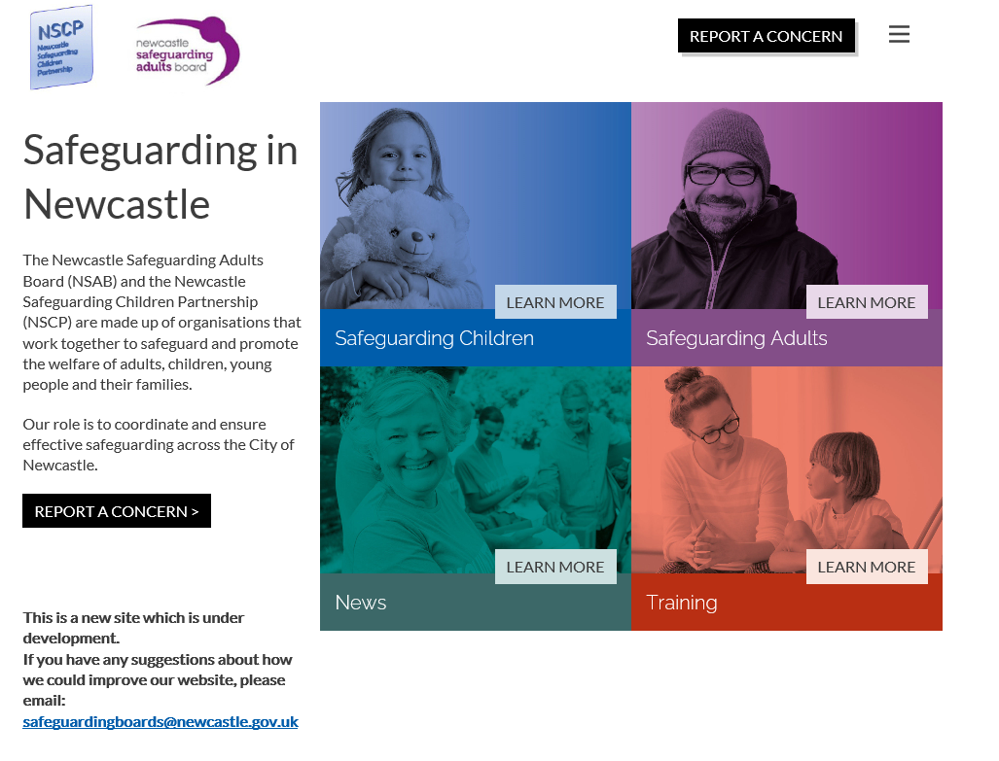

The new website - www.newcastlesafeguarding.org.uk for training information, resources and referrals

Slide 44

Questions and Evaluation

Slide 45

Thank you
Please complete the evaluation

