Slide 1


Introduction to
WeMatter
Vanessa Rowland & Elijah Giraudel – Project Leaders
victimsupport.org.uk

Slide 2

WeMatter – a digital service providing specialist support and information to children and young people who have experienced domestic abuse in their home, through the online delivery of the CYP Recovery Toolkit. WeMatter began as a pilot in Devon & Cornwall, Staffordshire, Warwickshire and Brent (London) from 1 July 2022 – 31st March 2024. Our new funding with Foundations has seen WeMatter expand its service delivery to include the whole of England. WeMatter - Victim Support
What is WeMatter?
victimsupport.org.uk

Slide 3

What is WeMatter?
The Recovery Toolkit programme is informed by Trauma Focused CBT, it offers a wide range of activities, games and discussions to support children in understanding and recovering from their experience of Domestic Abuse. Peer support element for CYP’s – Safe environment for children to explore their feelings and develop healthy coping strategies. Growth of healthy relationships and support networks. Increased anonymity. Option to attend a school-based (09:30 – 10:30; 13:30 – 14:30) or home-based group (16:00 – 17:00); each CYP receives an initial 1:1 and post-group 1:1. Digital support service that inclusive and accessible to all CYP’s.
victimsupport.org.uk

Slide 4
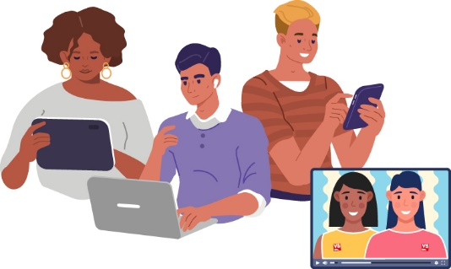
Referral Criteria
WeMatter welcomes referrals from parents and professionals for: CYP’s aged 8-17 years old. Across the whole of England. Experienced historic DA (no high risk cases) Ideally no longer living with alleged perpetrator of the abuse *will be assessed based on level of current risk. To make a referral please email wematter@victimsupport.org.uk or contact the WeMatter support line on 0300 373 0258 for more information. Completed referrals can also be sent to our triage team via email.
victimsupport.org.uk

Slide 5
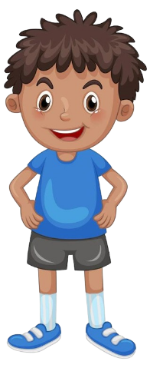
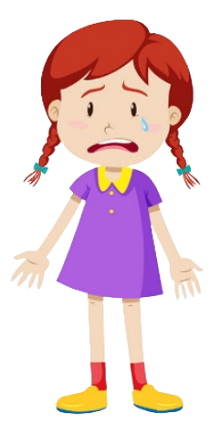


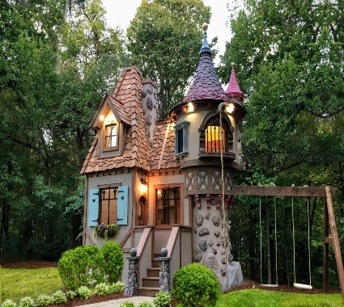






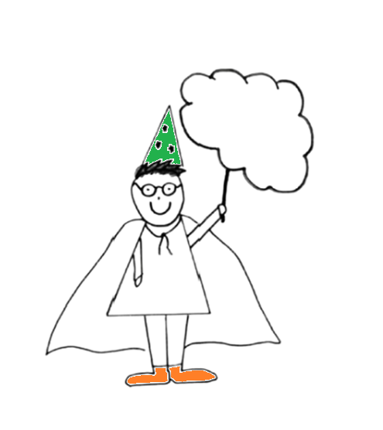
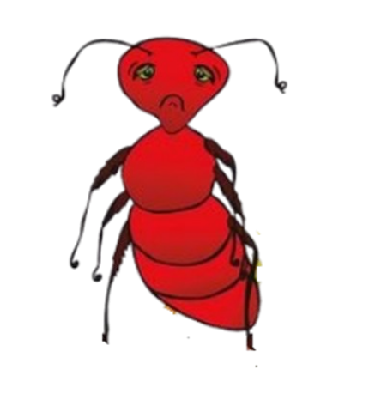
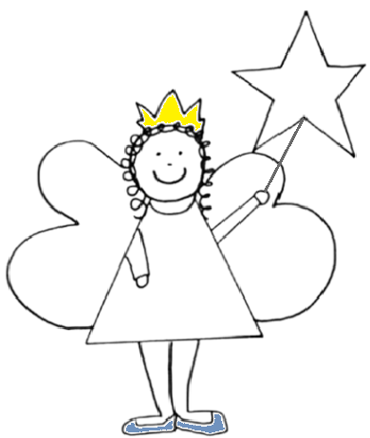


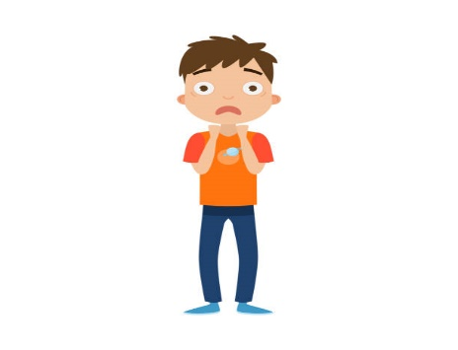





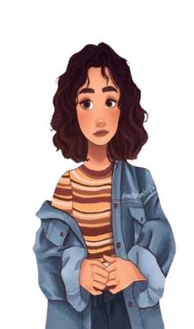
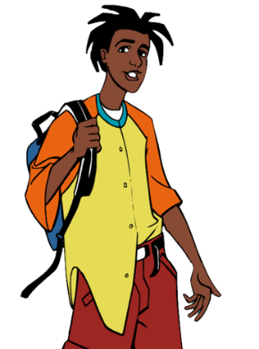

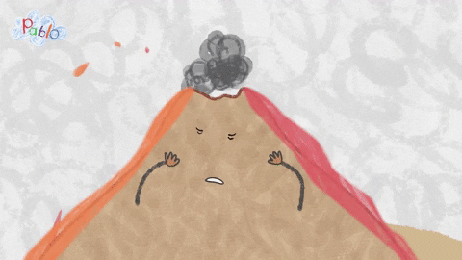

What else are we covering?
Session 1: Getting to know each other
Session 2: Why we act the way we do?
Session 3:Self-esteem & ANTs
Session 4: Family & Safety
Session 5: Being more positive!
Session 6: Handling difficult feelings
Session 7: Consent, trust and healthy relationships
Session 8: Games & Goodbyes
Group
Contract
☺
Fight
Freeze
Lets check in!
How are you today?
Flight
Notes:
Change to reflect new slides

Slide 6
So.. Why WeMatter?
Success from Pilot – 493 referrals received with an 85% engagement rate.
WeMatter evaluation – evidence based that this intervention does work.
90% of the younger group and 89% of the older group said that the online delivery was something that they “liked” or “liked it very much”
Providing a specialist support service at no cost to services locally up until March 2025
Support with local demand and capacity.
Reducing post code lottery for DA CYP services.
Positive feedback captured from service users, parents and professionals including a Youth Advisory Board made up of young people who have completed the WeMatter Programme.

Slide 7
“Thank you for all your help and support of [CYP], this has been the most impactful exercise/process that we and she has experienced (and we've tried quite a few outlets)” – Professional, Teacher.
“He is a changed child, the WeMatter sessions have done wonders for him and I have my lovely affectionate boy back. I can’t thank you enough for how much [CYP Programme Facilitators] have changed his outlook. He came home after every session and told me what he had been doing, I can’t even explain the difference in him” – Parent of CYP aged 13.
“You have put the foundations in place for her future. I have begged for help for her for years and nothing and now you guys have been a godsend and arrived at just the right time, thank you so very much” – Parent CYP aged 8.
'I liked that the meetings didn’t feel boring and I liked learning about ANTs and playing the games. If you ask my Mum how I am doing she will tell you I am so much better now. I have a really good sleep routine now, because that's important. I help out with chores now because I know how much that helps my Mum and I even have a girlfriend, I have been with her for a month' – CYP aged 13.

