Slide 1


Safeguarding Adults
Team Talk
Safeguarding adults at risk who have needs related to their drug/alcohol use

Slide 2
Introduction
A joint Safeguarding Adults Review (SAR) - Domestic Homicide Review (DHR) was completed in early 2025 in relation to Adult O. Adult O had care and support needs, primarily linked to her drug and alcohol use. She was the victim of domestic abuse over a long period of time from different intimate partners.
The Adult O SAR-DHR identified that there were missed opportunities for safeguarding adult referrals to be made. This may have been because there was lack of recognition of her vulnerability and/or abuse was hidden as a result of factors linked to drug and alcohol use (e.g. injuries presumed to be as a result of falls/accidents rather than abuse).
The Care Act 2014 is clear that care and support needs may arise as a result of a person’s substance misuse. Adults who have care and support needs related to their drug and or alcohol use are particularly vulnerable to abuse and neglect and may be less able to protect themselves from harm.

Slide 3
Think about someone you have worked with who has care and support needs because of their drug and/or alcohol use:
Team Talk Reflective Questions
What might some of the barriers be to making a safeguarding adults referral?
What are some of the factors that might lead to abuse or neglect being missed or overlooked?
Why might they be less able to protect themselves from harm?
How might stigma impact upon them getting the help and support they need?

Slide 4

2. In your experience, what has worked well in safeguarding adults with needs related to their drug/alcohol use? How have you overcome some of the barriers/factors discussed in question 1?
3. How confident are you in using legal frameworks to safeguard adults with needs related to their drug/alcohol use?
4. How confident do you feel to spot the signs someone is using drugs or alcohol and discuss their use with them?
5. Are you familiar with the services available to support adults who have needs related to their drug or alcohol use?
6. Final reflection – how will discussions today impact upon your practice?

Slide 5
Further resources and training
Drug and alcohol support in Newcastle animation
Stigma: A call-to-action animation
Anti-Stigma Network
Stigma-Practice Briefing
Stigma Kills (NHS Addictions Provider Alliance)
How to use legal powers to safeguard highly vulnerable dependent drinkers (Alcohol Change UK)
NSAB Safeguarding Adults Training
Newcastle City Council Public Health Training

Slide 6
How to use the Safeguarding Adults Team Talk
The Team Talk is divided up into three sections:
Background information/introduction – details any relevant legislation or learning from Safeguarding Adult Reviews (SARs). This information could be used to provide an introduction to the topic – why it is being discussed.
Team Talk Reflective Questions – suggested questions which should prompt discussion around a particular topic area. Is it not intended that there are right and wrong answers to these questions, hopefully they will facilitate discussion around the topic and give the opportunity for practitioners to share experiences and knowledge that are relevant to their role/profession/service. Try to take an appreciative approach (see below).
Further resources/training - includes a variety of resources, some of which could potentially be used within the team meeting e.g. showing a video/animation or are there for team members to access at a later date.
The Manager of the Team could send out the information in advance to allow team members to consider the topic and questions that are posed. Using the Team Meeting Training Tool could be used to evidence Continuing Professional Development (CPD) for those professions who are required to evidence this.
Taking an appreciative approach
Focus on Strengths and Positive Outcomes | Solution-Focused Reflection | Collaborative and Open Discussion
What went well? Celebrating successful safeguarding interventions and good practice. | “What solutions can we implement to improve this situation?” | Foster an open dialogue where everyone feels heard and valued.
Encouraging staff and volunteers to recognise and build on strengths within their teams and cases. | Focus on next steps and positive change. | Share ideas and experiences to promote mutual learning and team building
Notes:
The NSAB is exploring different ways that key messages can be cascaded to front-line staff. Although formal training can be an important aspect of learning, we are trying to encourage creative ways of learning - in diverse, flexible, and innovative ways. The Team Meeting Training Tool is intended to be used in a Team Meeting but could equally be used in a supervision scenario.

Slide 7
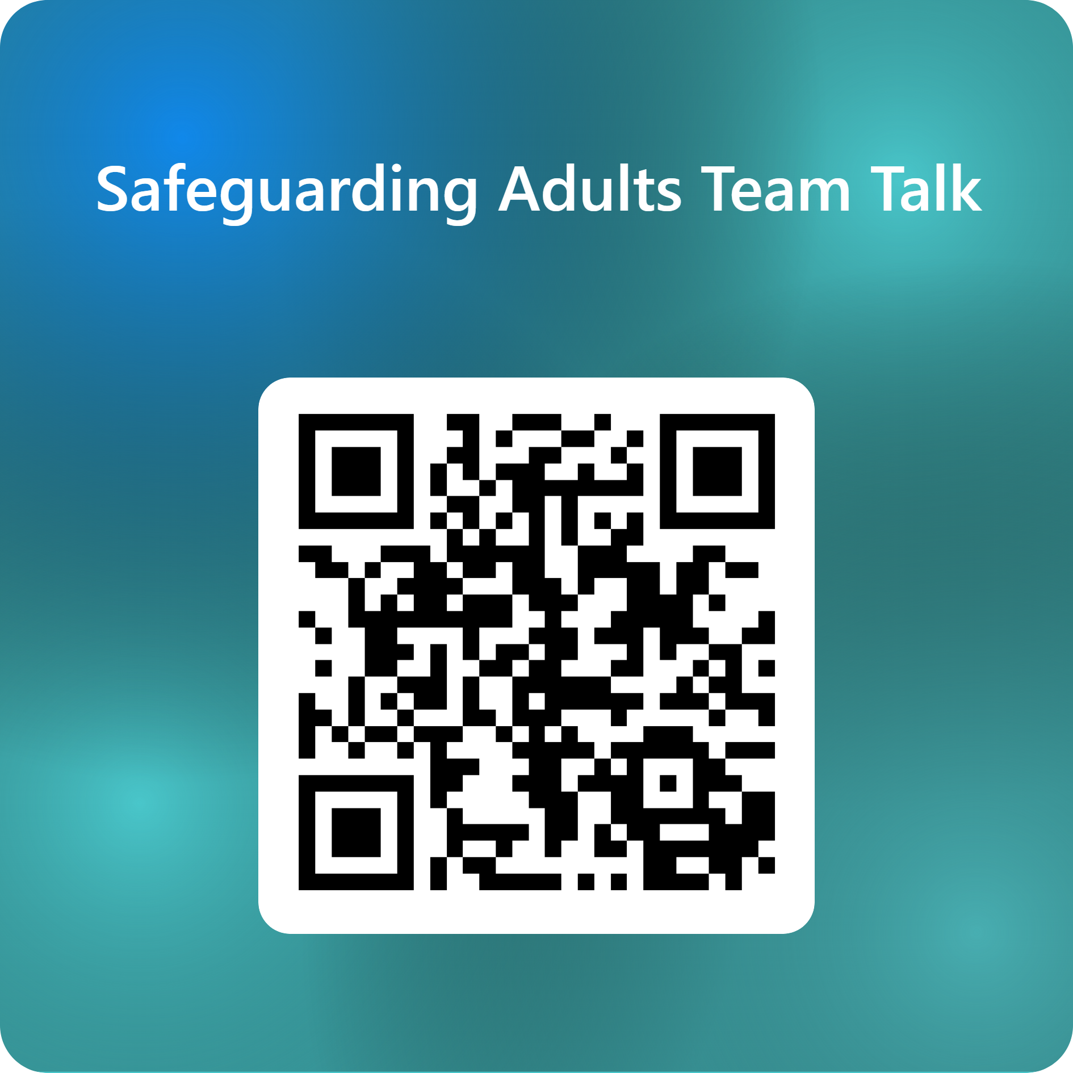
Feedback on the Team Talk
We'd like to know more about the use of the Team Talks, please complete this short survey to help us understand their use and improve them for the future.

Slide 8
www.newcastlesafeguarding.org.uk

