Slide 1


Safeguarding Adults Team Talk
Language, victim-blaming and stigma

Slide 2
Introduction
Stigmatising, dehumanising or victim-blaming language can have a big impact on adults at risk who we are trying to safeguard.
Language implying that an adult is complicit or responsible for the abuse, neglect or exploitation that has happened or may happen to them, must be avoided. People are targeted, and subjected to, abuse and exploitation.
Victim-blaming language may reinforce messages from perpetrators around shame and guilt. This may prevent the person from disclosing their abuse, through fear of being blamed by professionals. When victim-blaming language is used amongst professionals, there is a risk of normalising and minimising the person’s experience or the risk they face.

Slide 3
Introduction
Professionals must be aware that any recording will be subject to Third Party Disclosure should there be any criminal court case. Inappropriate use of language can have serious consequences within a criminal court context, and may impact upon convictions.
Sometimes jargon/slang terms are used to describe abusive situations e.g. “cuckooing”. These may be well understood by professionals but they can be dehumanising and in some circumstances minimise the risk, violence or abuse. Practitioners should be precise and professional in the language that they use.
Be professionally curious and avoid making assumptions that individuals are making choices. In the context of abuse, often a person’s choice is impacted by dependence, control, coercion or threats.

Slide 4

Have you come across times when the language used by professionals has had an impact on the safeguarding of an adult at risk?
Can you think of any circumstances where victim-blaming language might be more likely to happen?
Have you got any examples of strength’s based language/phrases that you use in your day-to-day work?
How do you go about self-checking the language/words that you use? Do you have any top tips?
How would you respectfully challenge inappropriate language or stigma by others?
Final reflection – how will discussions today impact upon your practice?
Team Talk
Reflective Questions

Slide 5
Further resources
NSAB Adult Exploitation Language Guidance
Making Words Matter: A Practice Knowledge Briefing (NWG)
Stigma: a call to action animation
Appropriate Language In Relation to Child Exploitation (Children’s Society)
Victim-Blaming Language (Waltham Forest Council)
Language in Social Work - Contextual Safeguarding (Social Work Action Group)
The Importance of Language Lunch and Learn (Safe Newcastle)

Slide 6
How to use the Safeguarding Adults Team Talk
The Team Talk is divided up into three sections:
Background information/introduction – details any relevant legislation or learning from Safeguarding Adult Reviews (SARs). This information could be used to provide an introduction to the topic – why it is being discussed.
Team Talk Reflective Questions – suggested questions which should prompt discussion around a particular topic area. Is it not intended that there are right and wrong answers to these questions, hopefully they will facilitate discussion around the topic and give the opportunity for practitioners to share experiences and knowledge that are relevant to their role/profession/service. Try to take an appreciative approach (see below).
Further resources/training - includes a variety of resources, some of which could potentially be used within the team meeting e.g. showing a video/animation or are there for team members to access at a later date.
The Manager of the Team could send out the information in advance to allow team members to consider the topic and questions that are posed. Using the Team Meeting Training Tool could be used to evidence Continuing Professional Development (CPD) for those professions who are required to evidence this.
Taking an appreciative approach
Focus on Strengths and Positive Outcomes | Solution-Focused Reflection | Collaborative and Open Discussion
What went well? Celebrating successful safeguarding interventions and good practice. | “What solutions can we implement to improve this situation?” | Foster an open dialogue where everyone feels heard and valued.
Encouraging staff and volunteers to recognise and build on strengths within their teams and cases. | Focus on next steps and positive change. | Share ideas and experiences to promote mutual learning and team building
Notes:
The NSAB is exploring different ways that key messages can be cascaded to front-line staff. Although formal training can be an important aspect of learning, we are trying to encourage creative ways of learning - in diverse, flexible, and innovative ways. The Team Meeting Training Tool is intended to be used in a Team Meeting but could equally be used in a supervision scenario.

Slide 7
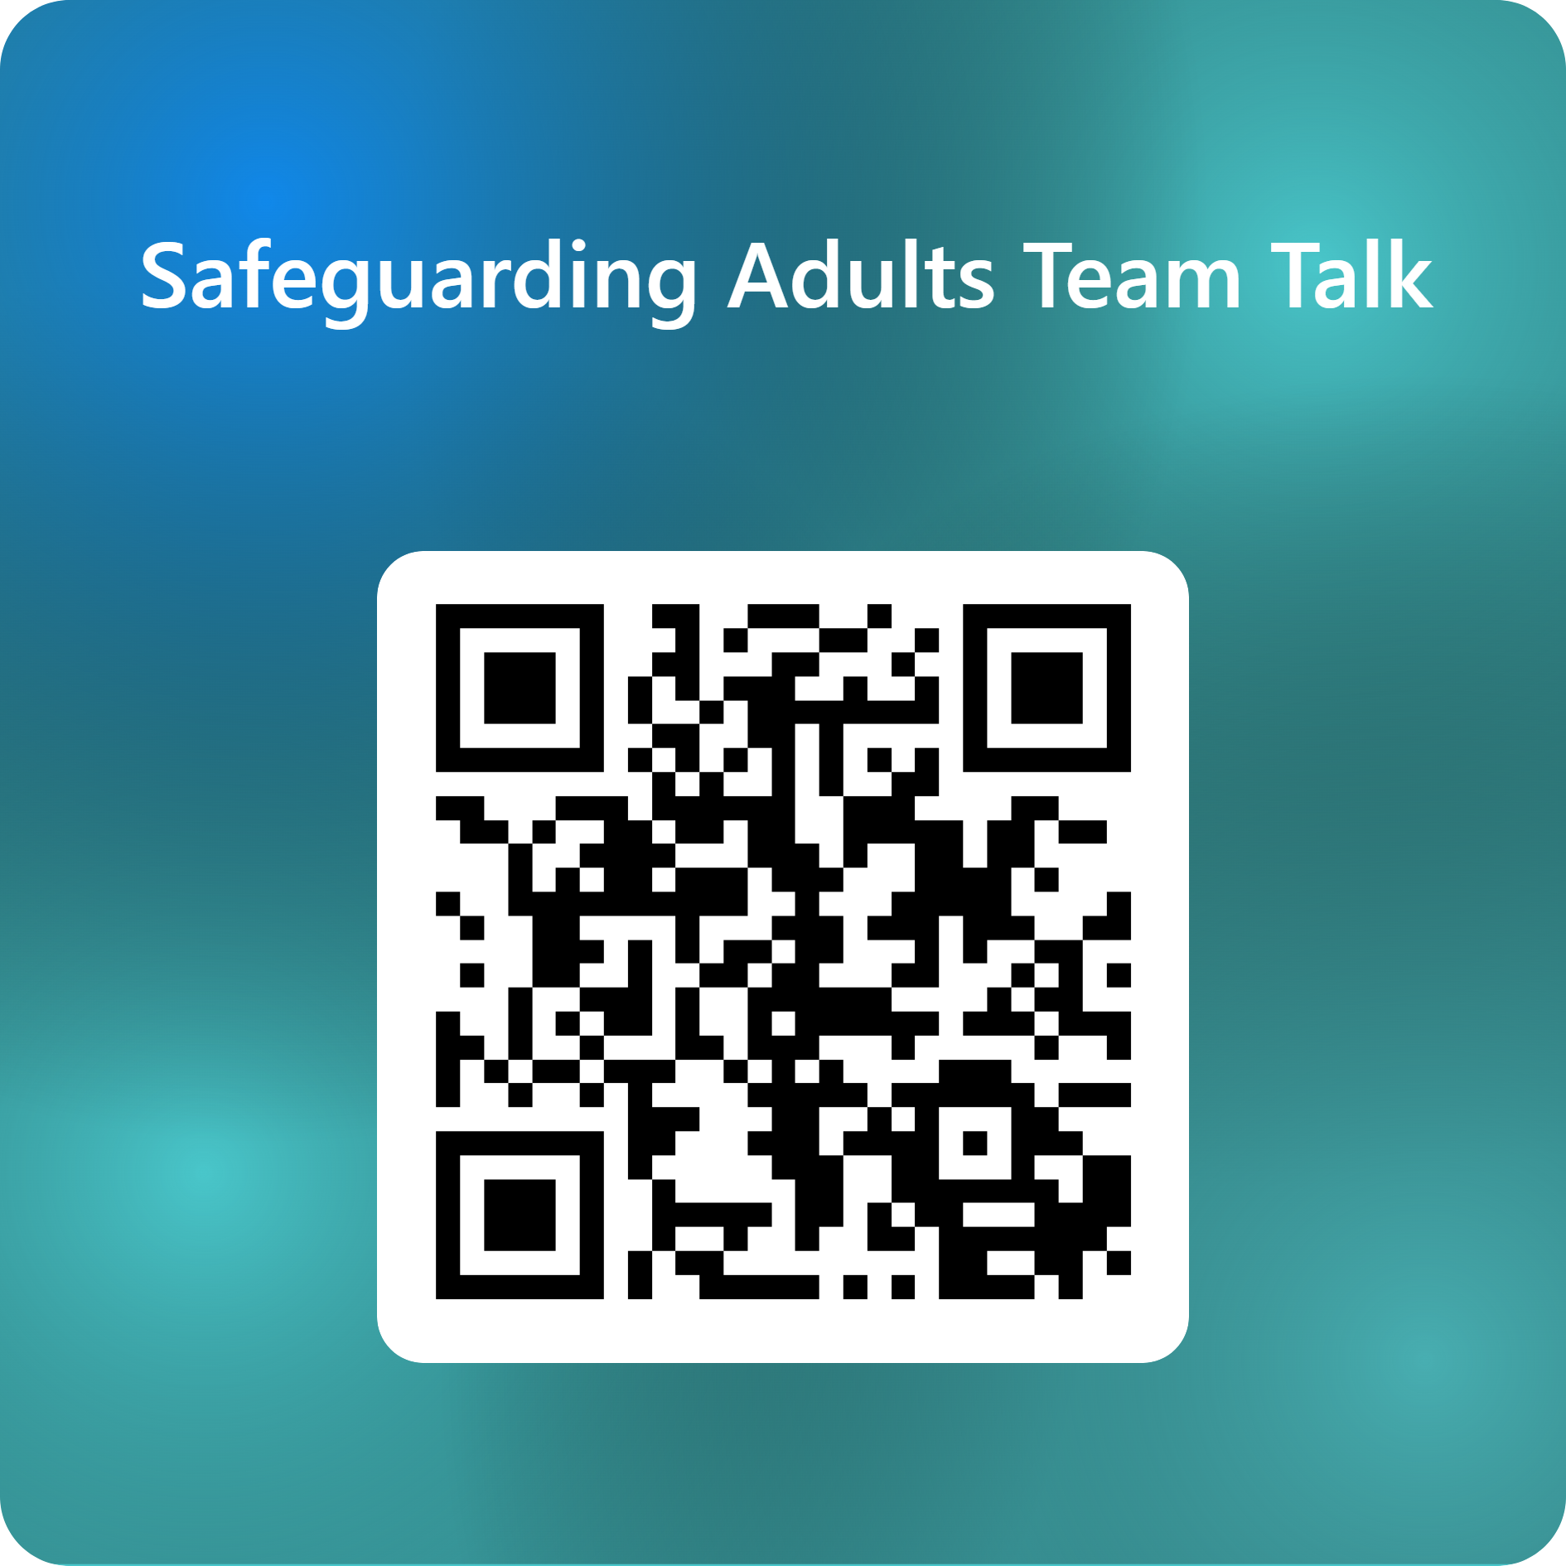
Feedback on the Team Talk
We'd like to know more about the use of the Team Talks, please complete this short survey to help us understand their use and improve them for the future.

Slide 8
www.newcastlesafeguarding.org.uk

