Slide 1


Safeguarding Adults
Team Talk
Organisational Cultures

Slide 2
Introduction
The culture of an organisation can impact on the likelihood of abuse/neglect happening.
An open culture is characterised by: transparent organisational structures and processes; employees who stimulate diversity, trust each other, approach each other positively; open communication; and managers/leaders who are supportive role models and who do not blame/shame.

Slide 3
Introduction
Risk factors that can lead to closed cultures include: people in a service are highly dependent on staff; people in the service are less able to speak up for themselves; people remain in a service for months or years; there is a high turnover of staff; restrictive practices are used; isolated geographical location; high number of out of area placements.
There have been a number of high profile Safeguarding Adult Reviews (e.g. Whorlton Hall in Durham and Joanna, Jon and Ben in Norfolk) where closed cultures have been a feature and serious harm has occured.

Slide 4

1. What signs and indicators might you come across that give you concerns about the culture within an organisation?
2. Sometimes concerns about an organisation’s culture can be hard to quantify, how would you overcome this potential barrier of taking action or sharing information?
3. Which other people/organisations might have information that help build up a picture of an organisation’s culture?
4.What would you do if you had concerns about an organisation’s culture?
5.How do you empower people and their families to know their rights and speak out?
6. What is in place in your organisation to ensure there is an open culture?
7. Final reflection – how will discussions today impact upon your practice?
Team Talk
Reflective Questions

Slide 5
Further resources
CQC work on closed cultures
Whorlton Hall SAR (Durham Safeguarding Adults Partnership)
Joanna, Jon, Ben SAR (Norfolk Safeguarding Adults Board)
Nightingale Homes SAR (South Gloucestershire Safeguarding Adults Board)
Safeguarding in care homes: the importance of open culture (SCIE Blog)
Organisational Abuse Regional Toolkit (North East ADASS)
Positive Workplace Cultures Toolkit (Skills for Care)
Closed cultures in social care: guidance and questions to ask (LGA)

Slide 6
How to use the Safeguarding Adults Team Talk
The Team Talk is divided up into three sections:
Background information/introduction – details any relevant legislation or learning from Safeguarding Adult Reviews (SARs). This information could be used to provide an introduction to the topic – why it is being discussed.
Team Talk Reflective Questions – suggested questions which should prompt discussion around a particular topic area. Is it not intended that there are right and wrong answers to these questions, hopefully they will facilitate discussion around the topic and give the opportunity for practitioners to share experiences and knowledge that are relevant to their role/profession/service. Try to take an appreciative approach (see below).
Further resources/training - includes a variety of resources, some of which could potentially be used within the team meeting e.g. showing a video/animation or are there for team members to access at a later date.
The Manager of the Team could send out the information in advance to allow team members to consider the topic and questions that are posed. Using the Team Meeting Training Tool could be used to evidence Continuing Professional Development (CPD) for those professions who are required to evidence this.
Taking an appreciative approach
Focus on Strengths and Positive Outcomes | Solution-Focused Reflection | Collaborative and Open Discussion
What went well? Celebrating successful safeguarding interventions and good practice. | “What solutions can we implement to improve this situation?” | Foster an open dialogue where everyone feels heard and valued.
Encouraging staff and volunteers to recognise and build on strengths within their teams and cases. | Focus on next steps and positive change. | Share ideas and experiences to promote mutual learning and team building
Notes:
The NSAB is exploring different ways that key messages can be cascaded to front-line staff. Although formal training can be an important aspect of learning, we are trying to encourage creative ways of learning - in diverse, flexible, and innovative ways. The Team Meeting Training Tool is intended to be used in a Team Meeting but could equally be used in a supervision scenario.

Slide 7
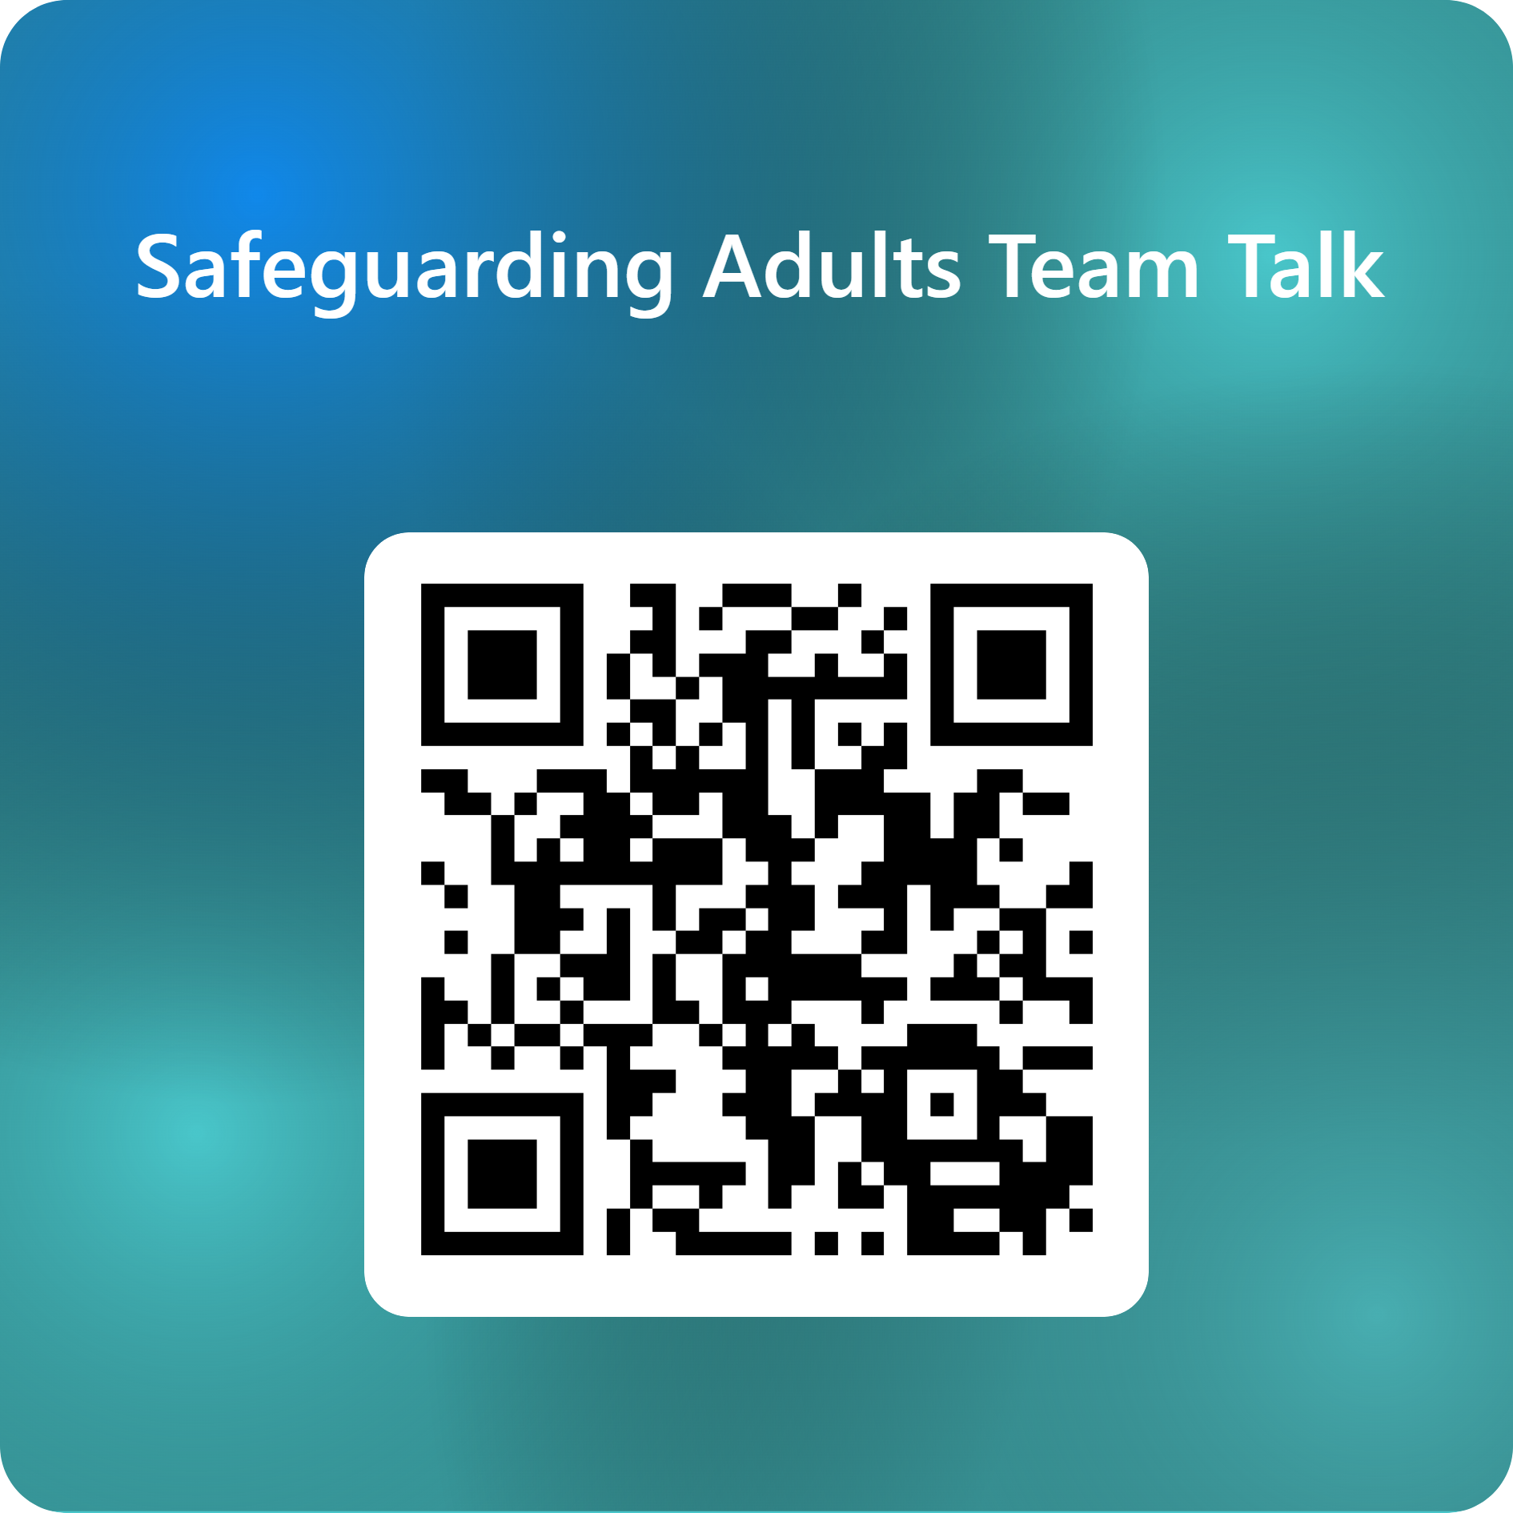
Feedback on the Team Talk
We'd like to know more about the use of the Team Talks, please complete this short survey to help us understand their use and improve them for the future.

Slide 8
www.newcastlesafeguarding.org.uk

