Slide 1


Safeguarding Adults Team Talk
FINANCIAL ABUSE

Slide 2
Introduction
Financial or material abuse involves the theft, fraud, exploitation, or coercion of an adult in relation to their financial affairs or arrangements. This includes issues connected to wills, property, inheritance, financial transactions, and the misuse or misappropriation of possessions, property, or benefits.
Financial abuse can affect individuals across all age groups, genders, income levels, and personal circumstances. It may occur as a one-off incident or continue over an extended period—sometimes lasting months or even years.
Care and support needs can increase a person's vulnerability to financial abuse, particularly when they rely on others for assistance with daily living or financial management. Abuse is most commonly perpetrated by someone known to the adult at risk—such as family members, friends, neighbours, or individuals in positions of trust. However, there is a growing risk of financial abuse from unknown perpetrators, including through scams, rogue traders, and other forms of financial exploitation.

Slide 3

What are some key signs and indicators that may suggest someone is at risk of financial abuse?
In addition to financial abuse, what other forms of abuse might a person be experiencing concurrently?
What personal or situational factors might increase an individual's vulnerability to financial abuse?
Who are the potential perpetrators of financial abuse, and what might their motivations or methods be?
What proactive strategies can be put in place to help prevent financial abuse and reduce the risk to individuals?
Final reflection: How have today’s discussions influenced your understanding, and how might they shape your future practice
Team Talk
Reflective Questions

Slide 4
Further resources
InformationNOW
Citizens Advice
Northumbria Police
NSAB Financial Abuse Guidance
Action Fraud
Newcastle Integrated Domestic Abuse Service (NIDAS)

Slide 5
How to use the Safeguarding Adults Team Talk
The Team Talk is divided up into three sections:
Background information/introduction – details any relevant legislation or learning from Safeguarding Adult Reviews (SARs). This information could be used to provide an introduction to the topic – why it is being discussed.
Team Talk Reflective Questions – suggested questions which should prompt discussion around a particular topic area. Is it not intended that there are right and wrong answers to these questions, hopefully they will facilitate discussion around the topic and give the opportunity for practitioners to share experiences and knowledge that are relevant to their role/profession/service. Try to take an appreciative approach (see below).
Further resources/training - includes a variety of resources, some of which could potentially be used within the team meeting e.g. showing a video/animation or are there for team members to access at a later date.
The Manager of the Team could send out the information in advance to allow team members to consider the topic and questions that are posed. Using the Team Meeting Training Tool could be used to evidence Continuing Professional Development (CPD) for those professions who are required to evidence this.
Taking an appreciative approach
Focus on Strengths and Positive Outcomes | Solution-Focused Reflection | Collaborative and Open Discussion
What went well? Celebrating successful safeguarding interventions and good practice. | “What solutions can we implement to improve this situation?” | Foster an open dialogue where everyone feels heard and valued.
Encouraging staff and volunteers to recognise and build on strengths within their teams and cases. | Focus on next steps and positive change. | Share ideas and experiences to promote mutual learning and team building
Notes:
The NSAB is exploring different ways that key messages can be cascaded to front-line staff. Although formal training can be an important aspect of learning, we are trying to encourage creative ways of learning - in diverse, flexible, and innovative ways. The Team Meeting Training Tool is intended to be used in a Team Meeting but could equally be used in a supervision scenario.

Slide 6
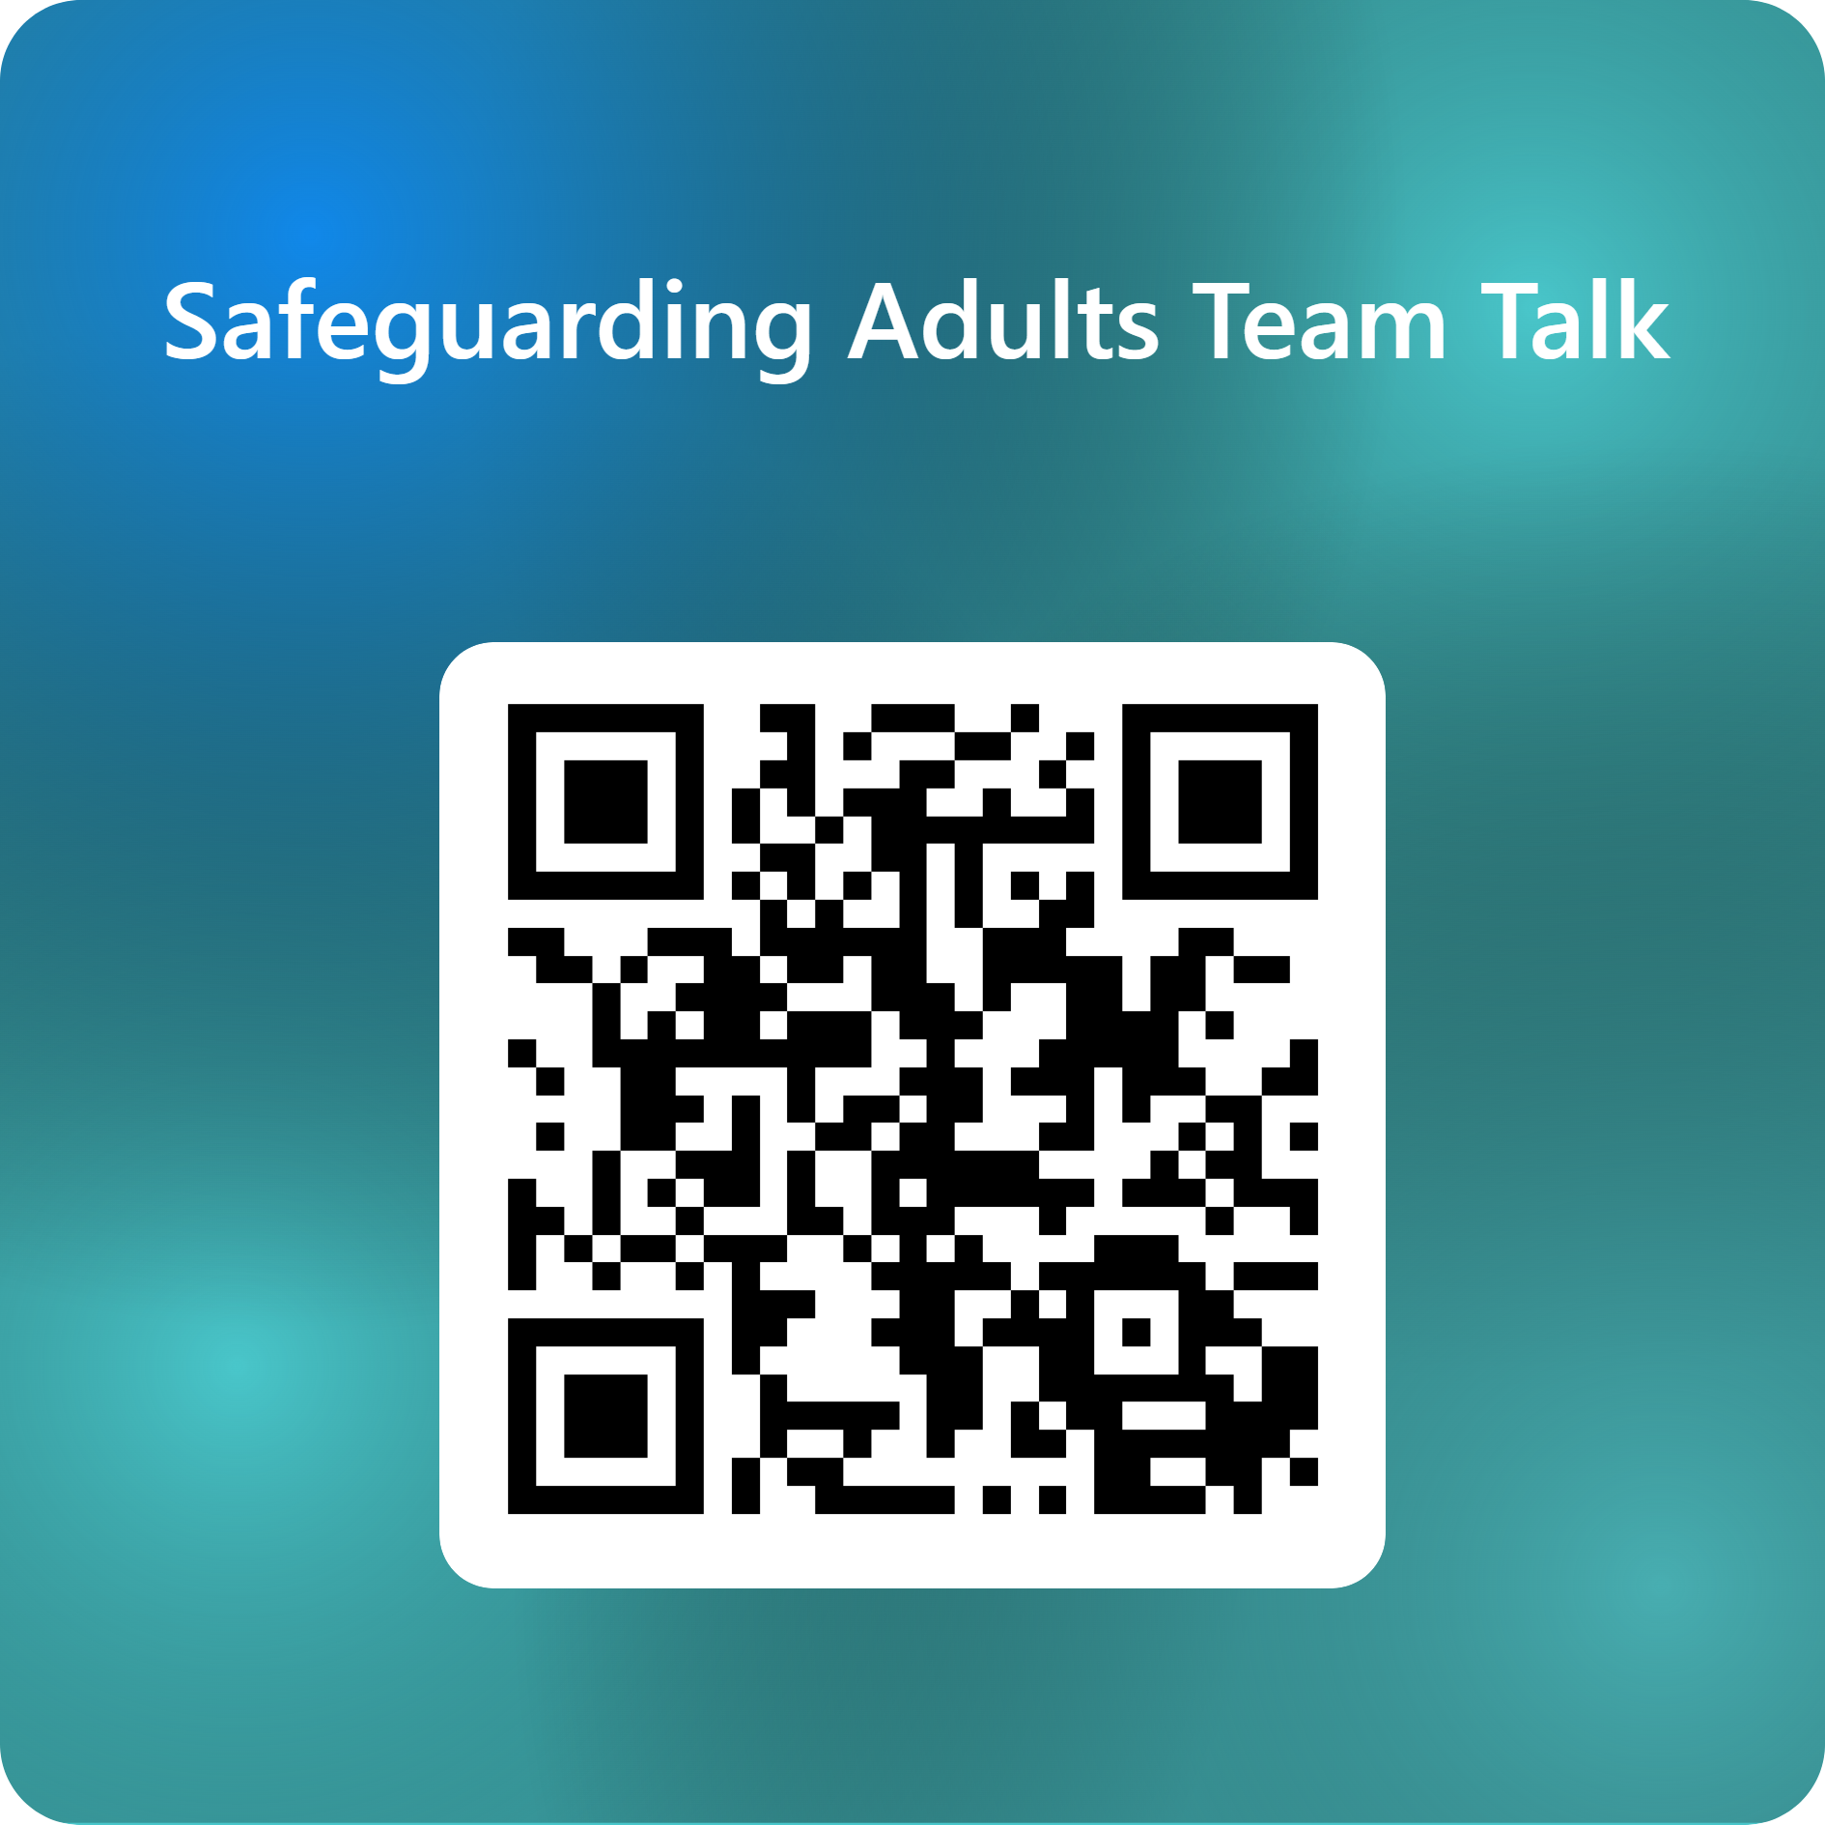
Feedback on the Team Talk
We'd like to know more about the use of the Team Talks, please complete this short survey to help us understand their use and improve them for the future.

Slide 7
www.newcastlesafeguarding.org.uk

