Slide 1


Safeguarding Adults Team Talk
Poverty & Safeguarding

Slide 2
Introduction
Poverty has a wide-reaching impact on people and communities. It can affect everything from health and education to mental well-being. It often creates a cycle that’s really hard to break— for the person going through it, family and even future generations. It’s not unusual for people to feel angry or even guilty about how much it affects their day-to-day life.
While poverty itself isn’t classed as a safeguarding issue, it can definitely lead to situations where people are more at risk. The stress and lack of options it brings can make life incredibly tough.

Slide 3
Introduction
Some of the safeguarding concerns that can come up include:
Not having enough food, warmth, or clothing. Professionals might call this “self-neglect,” but that can be misleading—it often isn’t really a choice.
Feeling isolated or cut off from others.
Stress in the home, which can sometimes lead to emotional or domestic abuse.
Struggles with learning and development, especially for children.
Long working hours that put pressure on relationships or mean children aren’t being properly supervised.
Extra pressure on people who are caring for others.
Low self-esteem and poor mental health.
A higher risk of turning to drugs or alcohol as a way to cope.
Being more vulnerable to exploitation by others who take advantage of the difficult circumstances and increased risks that come with poverty.

Slide 4

Can you think of a case from your experience where poverty played a role in increasing someone's vulnerability?
Poverty can have a wide-reaching impact beyond safeguarding. What other areas of a person’s life might be affected by poverty?
People experiencing poverty may rely on services like foodbanks. Can you think of a situation where accessing such services might have increased someone’s risk or vulnerability?
There is often a strong stigma attached to poverty. In your role, how can you help challenge this stigma and promote dignity and respect?
What practical support or signposting can you offer to individuals you work with to help reduce the impact of poverty on their wellbeing and safety?
Final reflection – how will discussions today impact upon your practice?
Team Talk
Reflective Questions

Slide 5
Further resources
Breaking the link between safeguarding and poverty, partnership for people and place
InformationNOW ‘Money’ landing page
Information about financial inclusion
Information about budgeting & debt advice
Information about Benefits
Information Now

Slide 6
How to use the Safeguarding Adults Team Talk
The Team Talk is divided up into three sections:
Background information/introduction – details any relevant legislation or learning from Safeguarding Adult Reviews (SARs). This information could be used to provide an introduction to the topic – why it is being discussed.
Team Talk Reflective Questions – suggested questions which should prompt discussion around a particular topic area. Is it not intended that there are right and wrong answers to these questions, hopefully they will facilitate discussion around the topic and give the opportunity for practitioners to share experiences and knowledge that are relevant to their role/profession/service. Try to take an appreciative approach (see below).
Further resources/training - includes a variety of resources, some of which could potentially be used within the team meeting e.g. showing a video/animation or are there for team members to access at a later date.
The Manager of the Team could send out the information in advance to allow team members to consider the topic and questions that are posed. Using the Team Meeting Training Tool could be used to evidence Continuing Professional Development (CPD) for those professions who are required to evidence this.
Taking an appreciative approach
Focus on Strengths and Positive Outcomes | Solution-Focused Reflection | Collaborative and Open Discussion
What went well? Celebrating successful safeguarding interventions and good practice. | “What solutions can we implement to improve this situation?” | Foster an open dialogue where everyone feels heard and valued.
Encouraging staff and volunteers to recognise and build on strengths within their teams and cases. | Focus on next steps and positive change. | Share ideas and experiences to promote mutual learning and team building
Notes:
The NSAB is exploring different ways that key messages can be cascaded to front-line staff. Although formal training can be an important aspect of learning, we are trying to encourage creative ways of learning - in diverse, flexible, and innovative ways. The Team Meeting Training Tool is intended to be used in a Team Meeting but could equally be used in a supervision scenario.

Slide 7
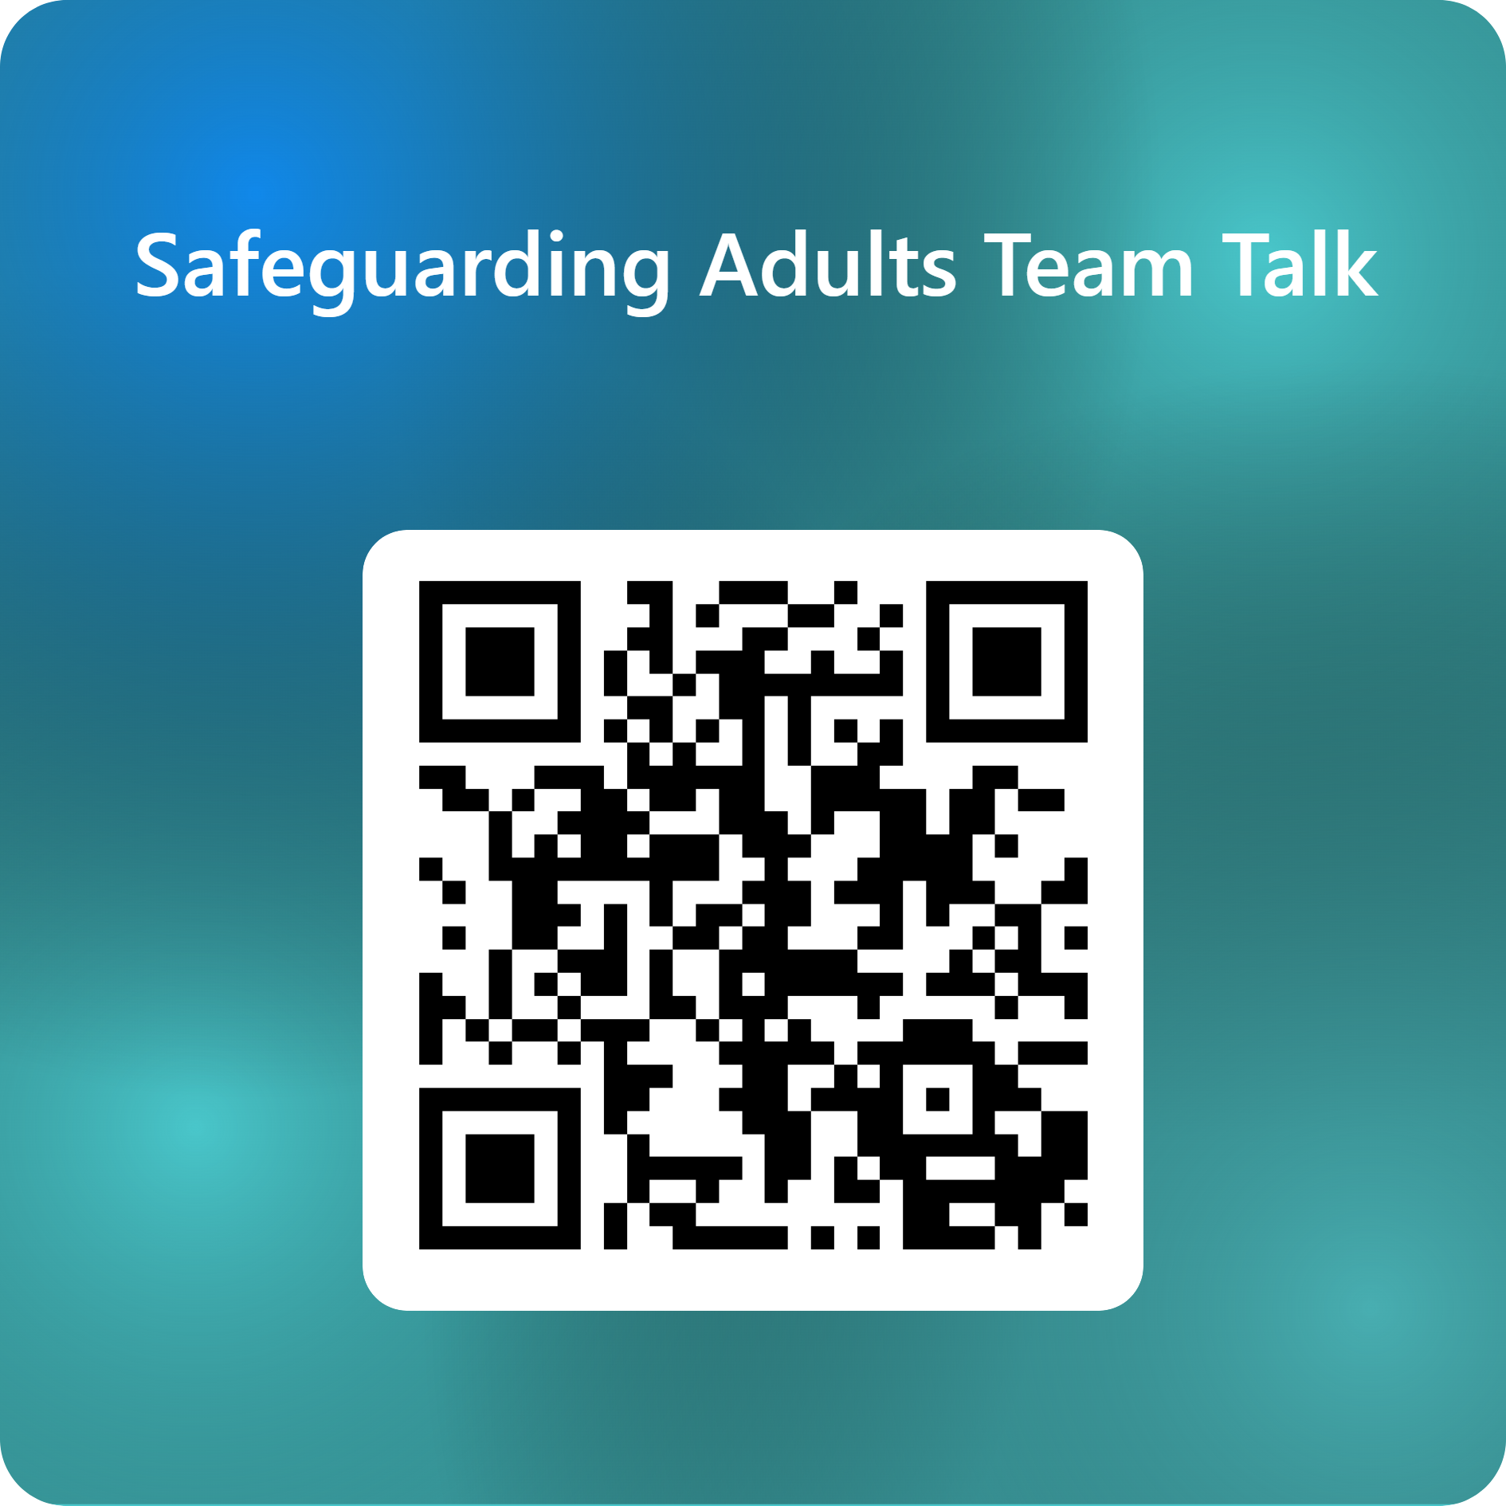
Feedback on the Team Talk
We'd like to know more about the use of the Team Talks, please complete this short survey to help us understand their use and improve them for the future.

Slide 8
www.newcastlesafeguarding.org.uk

