Slide 1


Safeguarding Adults Team Talk
INFORMATion SHARING

Slide 2
Introduction
Effective multi-agency safeguarding adults procedures require personal and sensitive information to be shared across agencies.
Data protection law does not prevent agencies from sharing information to safeguard adults at risk, it helps information to be shared in a fair, proportionate and lawful way.
Sharing information within safeguarding adults work ensures that adults at risk are effectively safeguarded, by providing all relevant parties with information they need in order to reduce risks or prevent abuse happening in the future.

Slide 3
Introduction
The “7 Golden Rules” of information sharing are: Necessary, Proportionate, Relevant, Adequate, Accurate, Timely, and Secure.
Confidentiality should never be confused with secrecy. There will be some circumstances when consent will not be sought because it is unsafe, or where consent will be overridden.

Slide 4

What types of personal and sensitive data do you think are shared as part of safeguarding adults enquiries and why are they necessary to be shared?
What are the different scenario’s when you would share information without the consent of the person?
Share your good practice examples of talking to someone about needing to override their consent.
What do the “7 Golden Rules” of information sharing mean to you in practice?
Who can you go to for advice if you are unsure about whether you can share information?
How will discussions today impact upon your practice?
Team Talk
Reflective Questions

Slide 5
Further resources
NSAB Information Sharing Agreement
Information Commissioners Office (ICO)
Safeguarding adults: sharing information SCIE Guide
ICO Training Videos
DfE Information Sharing Advice for practitioners providing safeguarding services for children, young people, parents and carers

Slide 6
How to use the Safeguarding Adults Team Talk
The Team Talk is divided up into three sections:
Background information/introduction – details any relevant legislation or learning from Safeguarding Adult Reviews (SARs). This information could be used to provide an introduction to the topic – why it is being discussed.
Team Talk Reflective Questions – suggested questions which should prompt discussion around a particular topic area. Is it not intended that there are right and wrong answers to these questions, hopefully they will facilitate discussion around the topic and give the opportunity for practitioners to share experiences and knowledge that are relevant to their role/profession/service. Try to take an appreciative approach (see below).
Further resources/training - includes a variety of resources, some of which could potentially be used within the team meeting e.g. showing a video/animation or are there for team members to access at a later date.
The Manager of the Team could send out the information in advance to allow team members to consider the topic and questions that are posed. Using the Team Meeting Training Tool could be used to evidence Continuing Professional Development (CPD) for those professions who are required to evidence this.
Taking an appreciative approach
Focus on Strengths and Positive Outcomes | Solution-Focused Reflection | Collaborative and Open Discussion
What went well? Celebrating successful safeguarding interventions and good practice. | “What solutions can we implement to improve this situation?” | Foster an open dialogue where everyone feels heard and valued.
Encouraging staff and volunteers to recognise and build on strengths within their teams and cases. | Focus on next steps and positive change. | Share ideas and experiences to promote mutual learning and team building
Notes:
The NSAB is exploring different ways that key messages can be cascaded to front-line staff. Although formal training can be an important aspect of learning, we are trying to encourage creative ways of learning - in diverse, flexible, and innovative ways. The Team Meeting Training Tool is intended to be used in a Team Meeting but could equally be used in a supervision scenario.

Slide 7
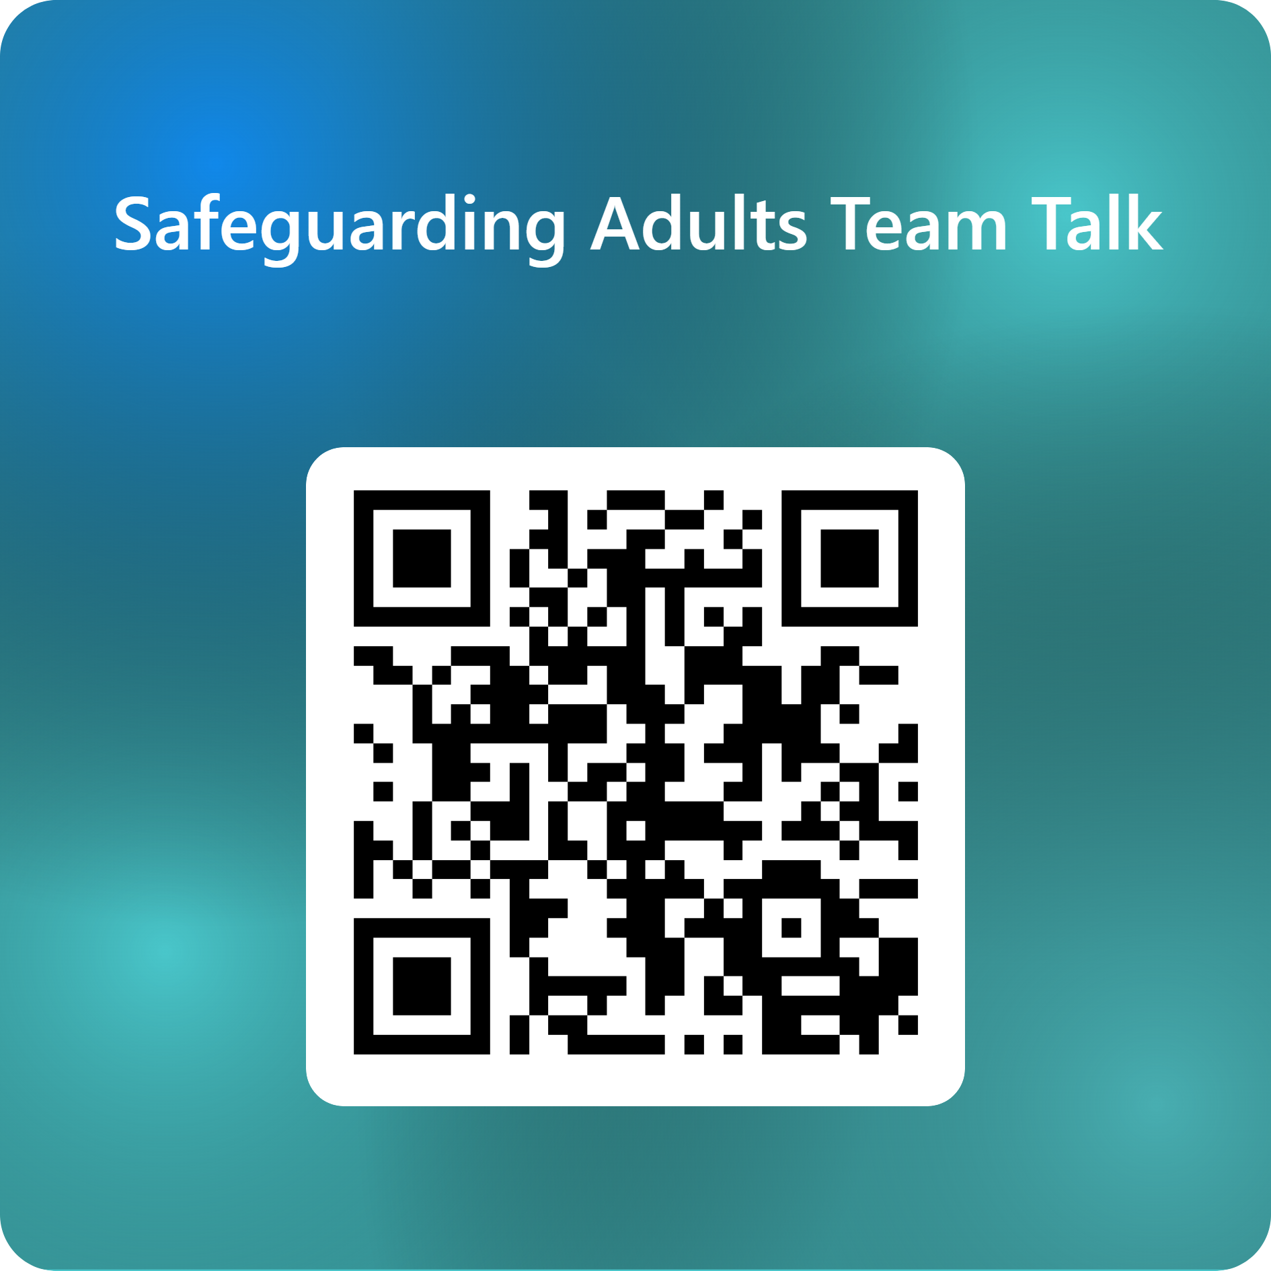
Feedback on the Team Talk
We'd like to know more about the use of the Team Talks, please complete this short survey to help us understand their use and improve them for the future.

Slide 8
www.newcastlesafeguarding.org.uk

