Slide 1


Safeguarding Adults Team Talk
Safeguarding adults week

Slide 2
Introduction
Safeguarding Adults Week is an annual campaign dedicated to raising awareness of key safeguarding issues and promoting best practices across communities. The week encourages collaboration, learning, and open conversations to help to keep people as safe as possible.
A Focus on Prevention. Rather than simply reacting to incidents, Safeguarding Adults Week highlights the importance of taking proactive steps to prevent abuse and neglect. It promotes early intervention and encourages individuals and organisations to recognise and respond to risks before harm occurs.
Collaboration is Key. Safeguarding is a shared responsibility. The campaign emphasises the vital role that individuals, organisations, and communities play in working together to protect adults at risk. By working in partnerships and sharing knowledge, we can strengthen safeguarding efforts and create more supportive environments.

Slide 3
Introduction
Raising Awareness. A central aim of the week is to increase public understanding of safeguarding issues. It encourages people to speak up, report concerns, and seek support—whether for themselves or others. By generating conversations around safeguarding, we can break down stigma and empower people to take action.
What is Safeguarding Adults? Safeguarding adults refers to the measures taken to protect individuals at risk from abuse and neglect. It’s about promoting their right to live safely, free from harm, and ensuring their overall well-being. Adults at risk are defined as individuals aged 18 or over who need care and support, are experiencing or at risk of abuse or neglect, and are unable to protect themselves from harm.

Slide 4

Why might someone be deemed to be an “adult at risk”?
What is abuse?
Who might perpetrate abuse?
Can you name any of the 10 types of abuse which are mentioned in the Care Act 2014
Who would you speak to if you had concerns that an adult is at risk of abuse or neglect?
Can you think of any signs or indicators that someone might be experiencing abuse or neglect?
Would you know how to contact Adult Social Care if you had concerns about yourself or another person?
Team Talk
Reflective Questions

Slide 5
How to get involved
Check out the Newcastle Safeguarding website www.newcastlesafeguarding.org.uk
See what events we have upcoming for Safeguarding Adults Week
Access our safeguarding adults team in community locations
See what your local services and organisation are doing to help to raise awareness of safeguarding for safeguarding adults week
Find out more information about Safeguarding Adults Week nationally on the Ann Craft Trust website: www.anncrafttrust.org/events/safeguarding-adults-week/

Slide 6
How to use the Safeguarding Adults Team Talk
The Team Talk is divided up into three sections:
Background information/introduction – details any relevant legislation or learning from Safeguarding Adult Reviews (SARs). This information could be used to provide an introduction to the topic – why it is being discussed.
Team Talk Reflective Questions – suggested questions which should prompt discussion around a particular topic area. Is it not intended that there are right and wrong answers to these questions, hopefully they will facilitate discussion around the topic and give the opportunity for practitioners to share experiences and knowledge that are relevant to their role/profession/service. Try to take an appreciative approach (see below).
Further resources/training - includes a variety of resources, some of which could potentially be used within the team meeting e.g. showing a video/animation or are there for team members to access at a later date.
The Manager of the Team could send out the information in advance to allow team members to consider the topic and questions that are posed. Using the Team Meeting Training Tool could be used to evidence Continuing Professional Development (CPD) for those professions who are required to evidence this.
Taking an appreciative approach
Focus on Strengths and Positive Outcomes | Solution-Focused Reflection | Collaborative and Open Discussion
What went well? Celebrating successful safeguarding interventions and good practice. | “What solutions can we implement to improve this situation?” | Foster an open dialogue where everyone feels heard and valued.
Encouraging staff and volunteers to recognise and build on strengths within their teams and cases. | Focus on next steps and positive change. | Share ideas and experiences to promote mutual learning and team building
Notes:
The NSAB is exploring different ways that key messages can be cascaded to front-line staff. Although formal training can be an important aspect of learning, we are trying to encourage creative ways of learning - in diverse, flexible, and innovative ways. The Team Meeting Training Tool is intended to be used in a Team Meeting but could equally be used in a supervision scenario.

Slide 7
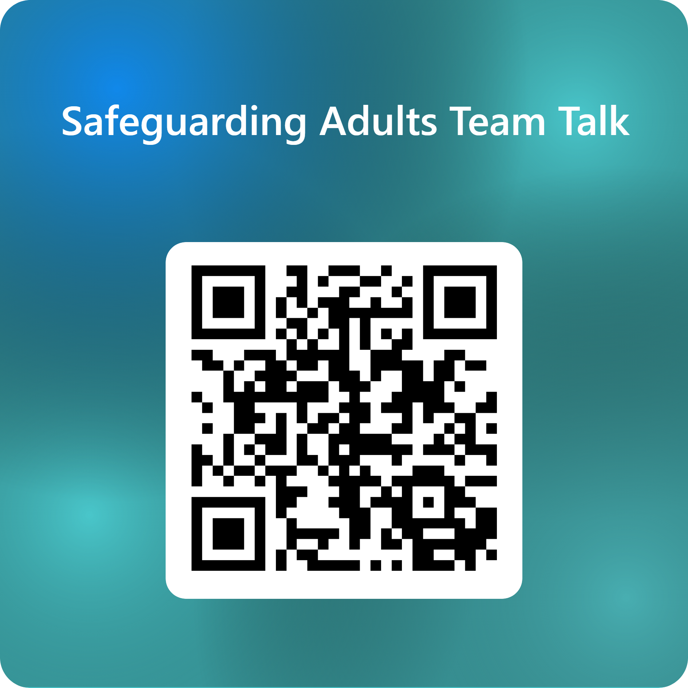
Feedback on the Team Talk
We'd like to know more about the use of the Team Talks, please complete this short survey to help us understand their use and improve them for the future.

Slide 8
www.newcastlesafeguarding.org.uk

