Slide 1


Safeguarding Adults
Team Talk
Executive Function
&
Mental Capacity Act considerations

Slide 2
Introduction
Executive functioning refers to the thinking skills that allow a person to plan, control impulses, weigh consequences, and turn decisions into action. Although it is not named in the Mental Capacity Act (MCA), executive functioning is closely linked to the MCA requirement that a person must be able to use or weigh information. In practice, some people can clearly explain risks and options and appear to understand them, but struggle to follow through with protective actions or to change behaviour over time. This is often described as being able to “talk the talk but not walk the walk.”
Executive functioning difficulties are particularly relevant in safeguarding situations involving substance misuse, trauma, mental ill‑health, or brain injury, where capacity may fluctuate or be undermined in real‑world settings. The MCA makes clear that unwise decisions alone do not equal lack of capacity, but repeated harm or escalating risk may indicate difficulty using or weighing information rather than free choice. Good practice requires looking beyond one‑off, conversation‑based assessments; observing behaviour over time; sharing information across agencies; and revisiting capacity as circumstances change, to ensure decisions are lawful, proportionate, and rights‑respecting.

Slide 3
Have you worked with someone who could explain risks but struggled to act on that understanding? What got in the way, and how did we evidence this in our practice?
How do we move beyond a one‑off, conversation‑based MAC to understand if someone can truly use or weigh information in real‑world situations?
When drug or alcohol use is present, how do we challenge assumptions about “lifestyle choice” and remain curious about the impact of dependency, trauma, or executive dysfunction?
At what point do repeated safeguarding concerns or escalating risks tell us that we need to revisit capacity, escalate concerns, or seek multi‑agency challenge or legal advice?
Final reflection – how will discussions today impact upon the things you do to keep adults at risk safe?
Team Talk
Reflective Questions

Slide 4
Further resources
Executive Function: Practice Note for Mental Capacity Assessments (Procedures Online, 2024)
Executive Functioning and Mental Capacity – Safeguarding Adults Board guidance created by Lancashire
BASW Briefing: Mental Capacity, Alcohol and Other Drug Use
NICE guidance on co‑existing mental illness and substance misuse (NG58 / CG120)
Practice Guidance

Slide 5
How to use the Safeguarding Adults Team Talk
The Team Talk is divided up into three sections:
Background information/introduction – details any relevant legislation or learning from Safeguarding Adult Reviews (SARs). This information could be used to provide an introduction to the topic – why it is being discussed.
Team Talk Reflective Questions – suggested questions which should prompt discussion around a particular topic area. Is it not intended that there are right and wrong answers to these questions, hopefully they will facilitate discussion around the topic and give the opportunity for practitioners to share experiences and knowledge that are relevant to their role/profession/service. Try to take an appreciative approach (see below).
Further resources/training - includes a variety of resources, some of which could potentially be used within the team meeting e.g. showing a video/animation or are there for team members to access at a later date.
The Manager of the Team could send out the information in advance to allow team members to consider the topic and questions that are posed. Using the Team Meeting Training Tool could be used to evidence Continuing Professional Development (CPD) for those professions who are required to evidence this.
Taking an appreciative approach
Focus on Strengths and Positive Outcomes | Solution-Focused Reflection | Collaborative and Open Discussion
What went well? Celebrating successful safeguarding interventions and good practice. | “What solutions can we implement to improve this situation?” | Foster an open dialogue where everyone feels heard and valued.
Encouraging staff and volunteers to recognise and build on strengths within their teams and cases. | Focus on next steps and positive change. | Share ideas and experiences to promote mutual learning and team building
Notes:
The NSAB is exploring different ways that key messages can be cascaded to front-line staff. Although formal training can be an important aspect of learning, we are trying to encourage creative ways of learning - in diverse, flexible, and innovative ways. The Team Meeting Training Tool is intended to be used in a Team Meeting but could equally be used in a supervision scenario.

Slide 6
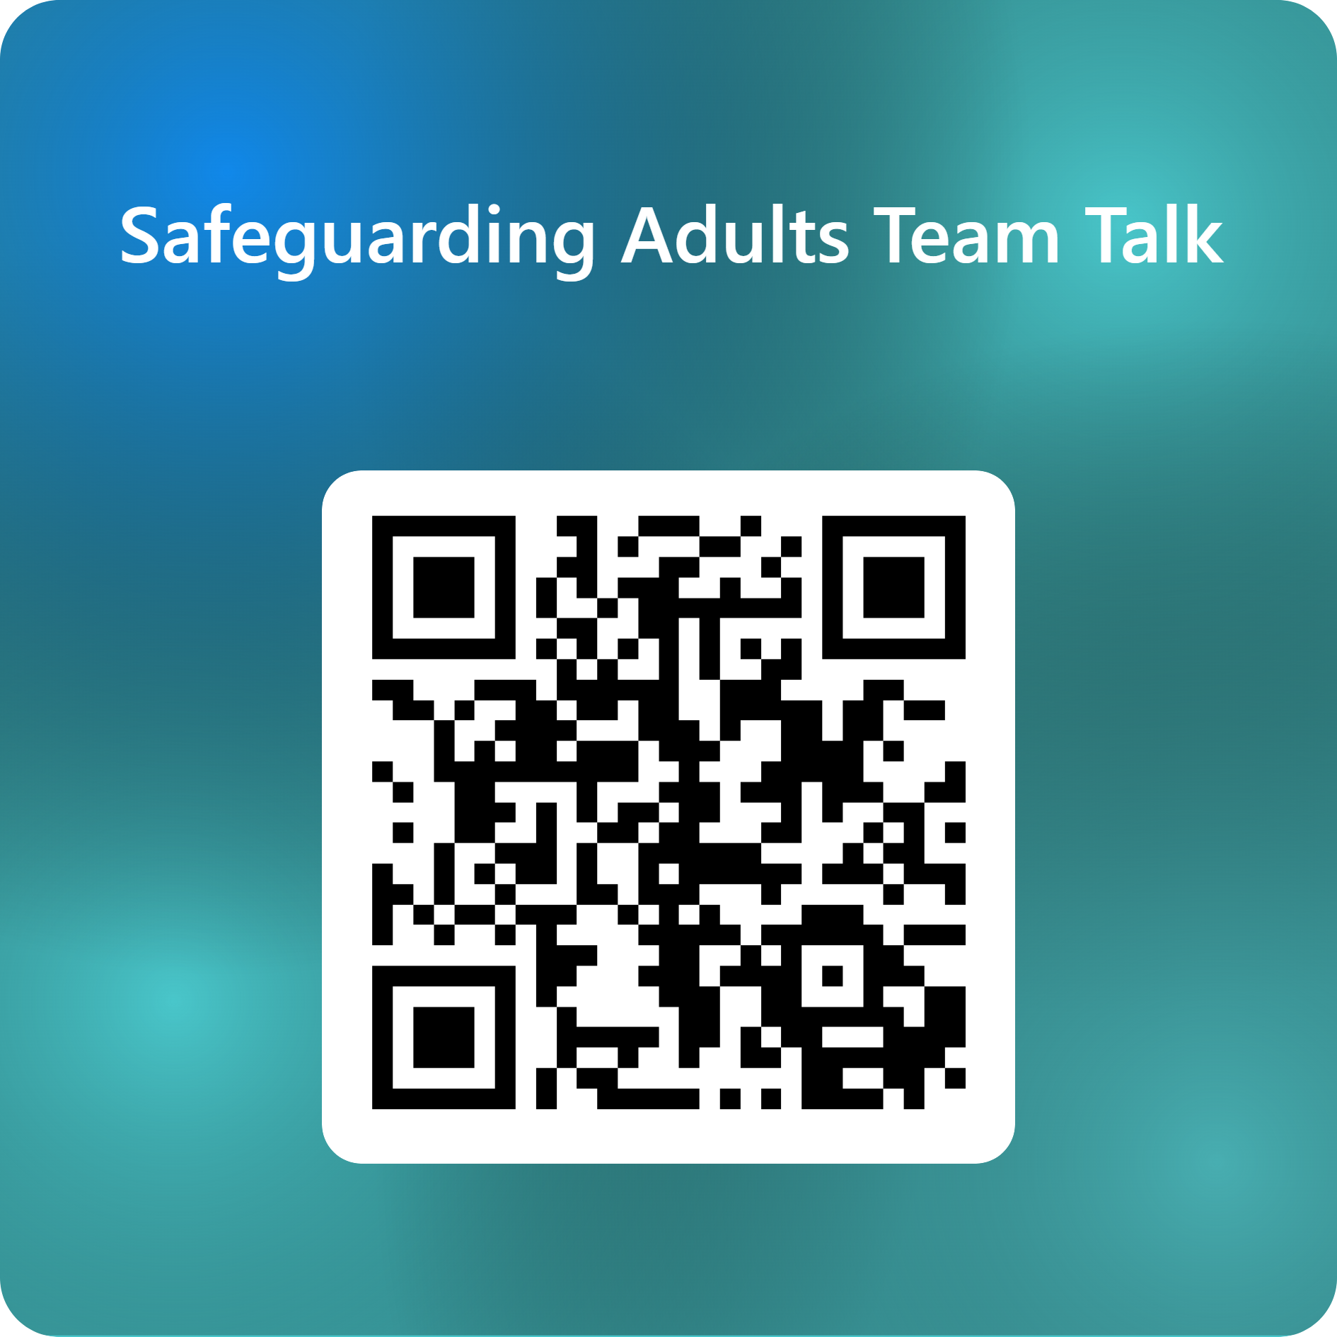
Feedback on the Team Talk
We'd like to know more about the use of the Team Talks, please complete this short survey to help us understand their use and improve them for the future.

Slide 7
www.newcastlesafeguarding.org.uk

